Slide 1
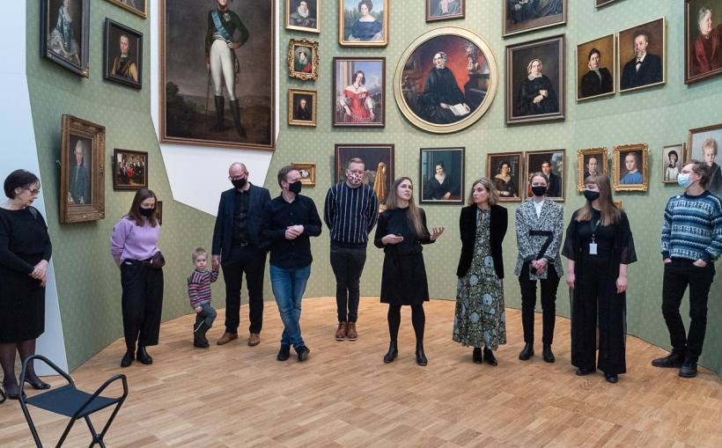
Thematic Discussion: How monuments [and images] construct and reconstruct what we remember? Linda Kaljundi (Estonian Academy of Arts) – on behalf of the Landscapes of Identity exhibition team (Kumu Art Museum)
European Heritage Heads Forum
Tallinn 8–10 September 2021

Slide 2
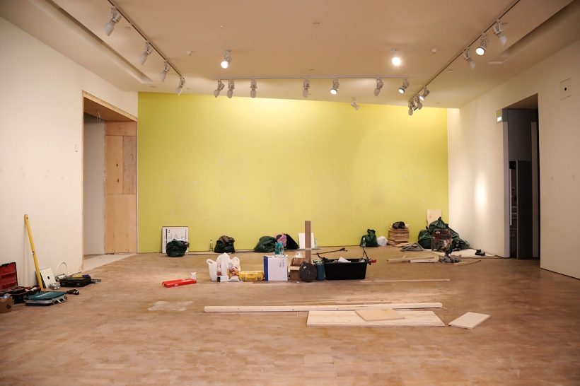
Landscapes of Identity: Estonian Art 1700–1945 New permanent exhibition at Kumu Art Museum (2021)
permanent exhibition – at a major national art museum – as a medium for deconstructing and reconstructing cultural memory?

Slide 3
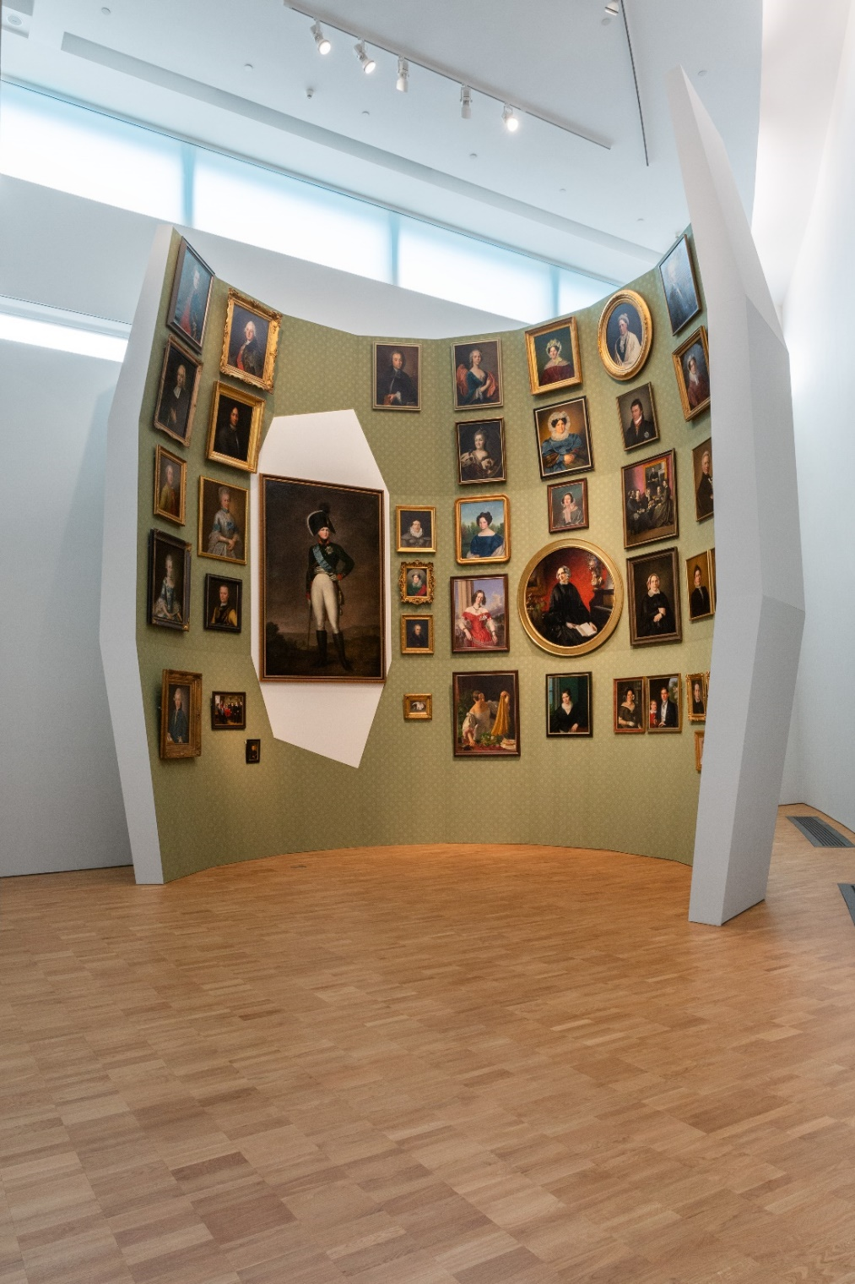
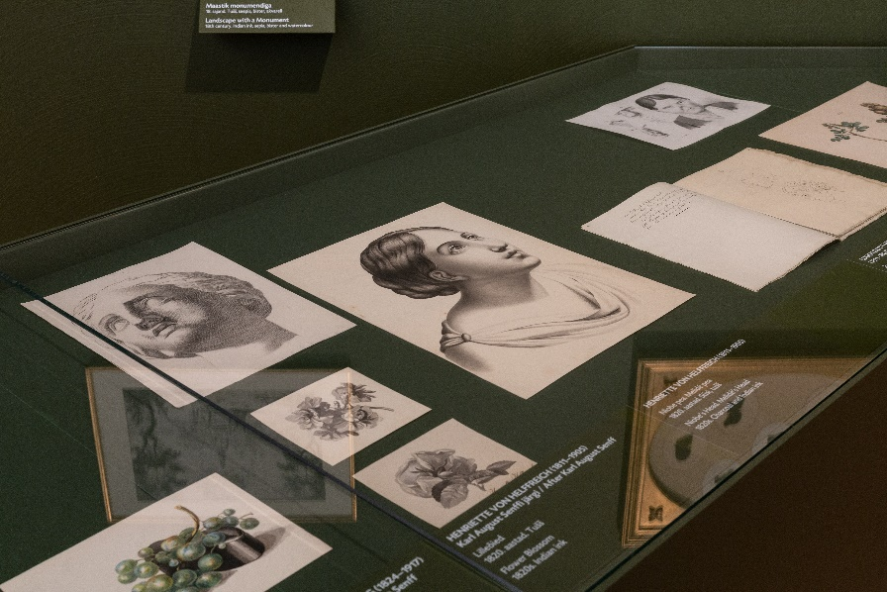
thinking and moving (canonical) artworks outside of the box connections between visual culture and other media of cultural memory transnational and transcultural perspectives uncanonical authors and genres: women and amateur artists, scientific and educational images, design, etc. project spaces, interventions by contemporary artists

Slide 4
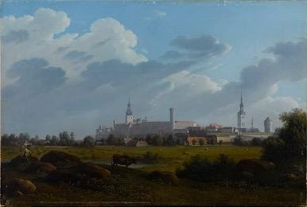
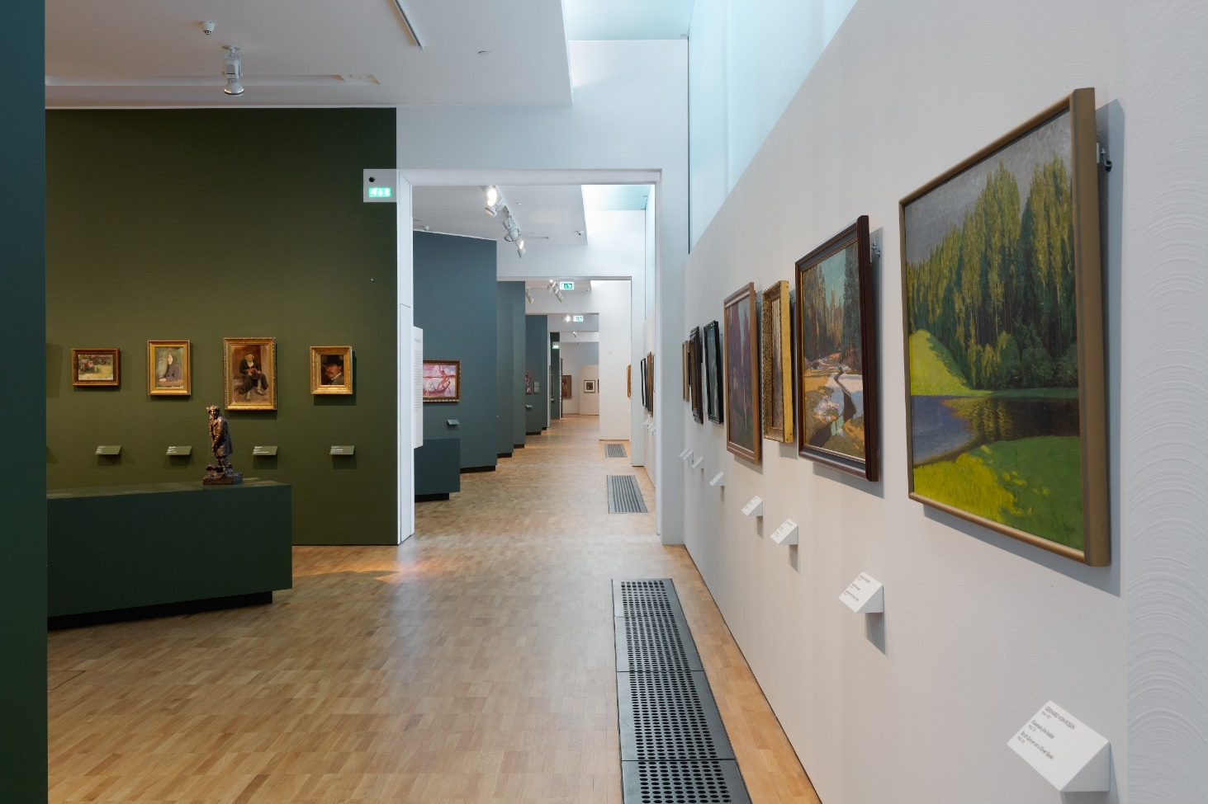
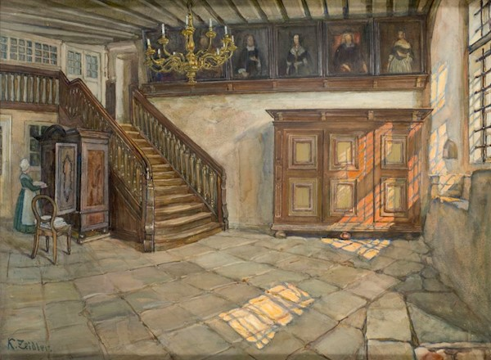
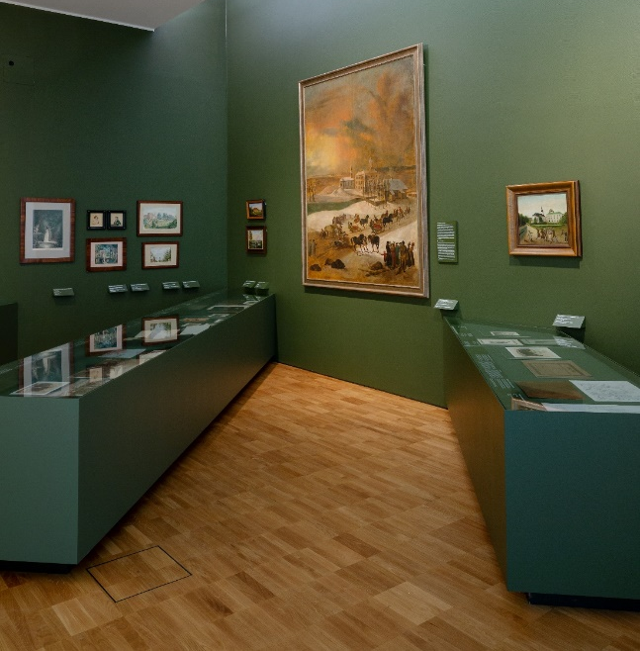
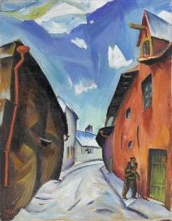
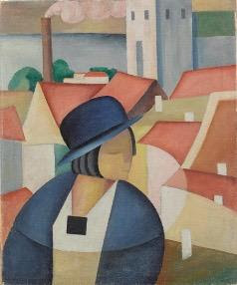
Landscapes of Identity: Estonian art 1700–1945
transnational, multi-ethnic history and heritage
Estonian, Baltic German, Russian traditions
focus: art – identity – society
Baltic German and Estonian entanglements, Russian imperial gaze, visual culture and nation building, utopias and dystopias of modernity, art and authoritarian regime of the 1930s, World War II

Slide 5
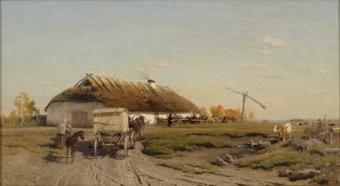
Oskar Hoffmann, On the Road to the Market (1894–1899) Johann Köler, Homestead of the Artist (1868)
re-connecting and re-constructing Baltic-German and Estonian canon

Slide 6
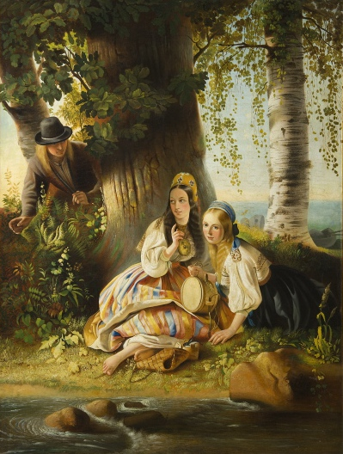
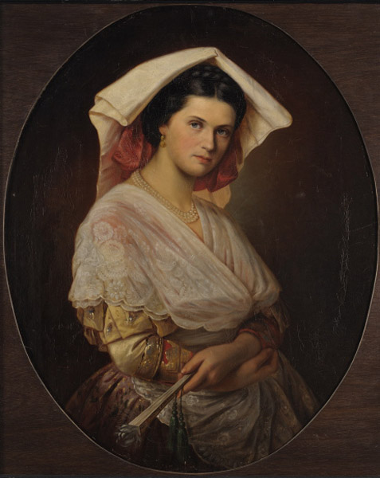
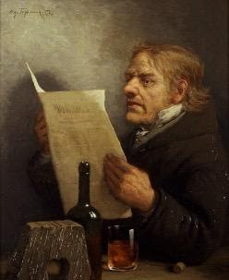
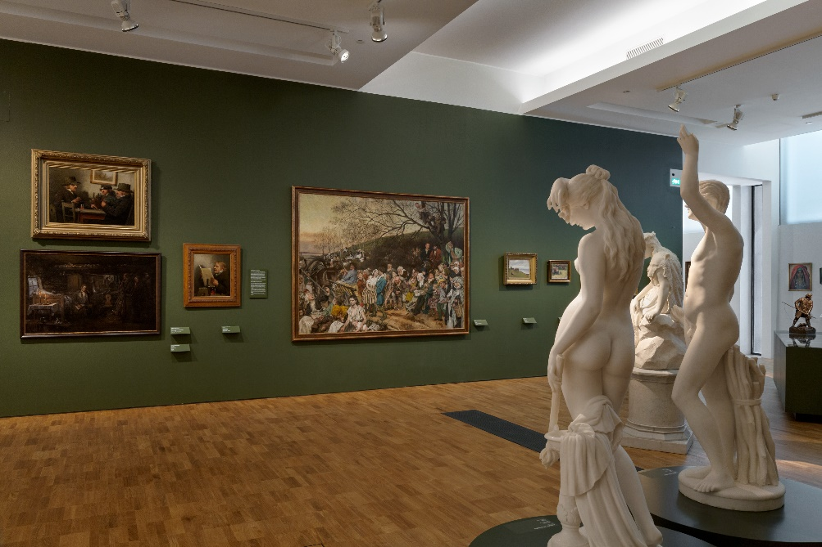
transnational peasants Italian and German, imperial and romantic gaze

Slide 7
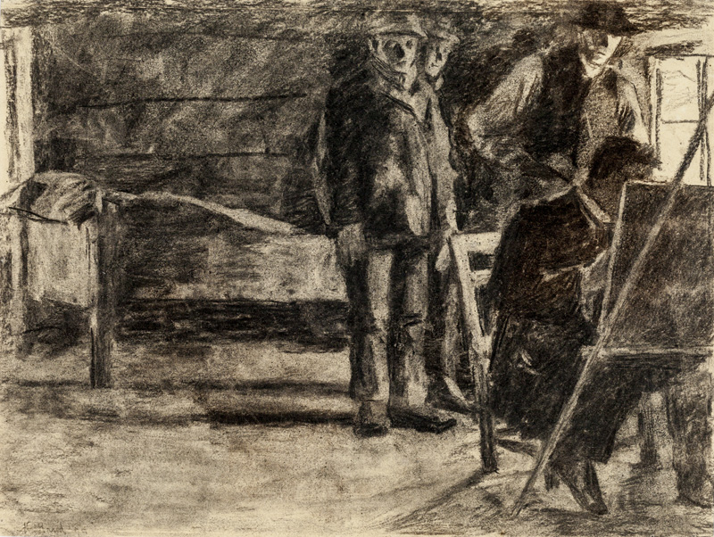
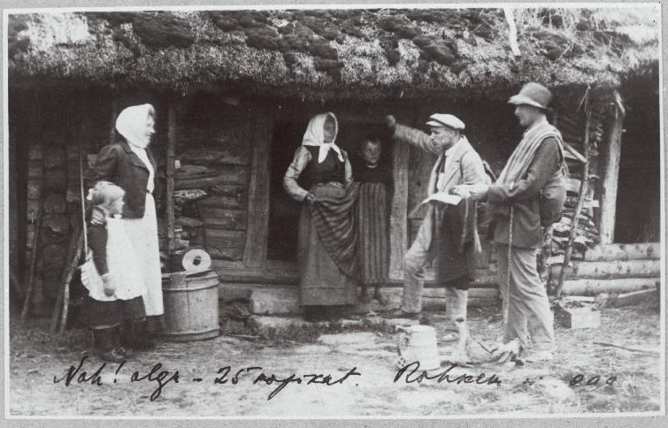
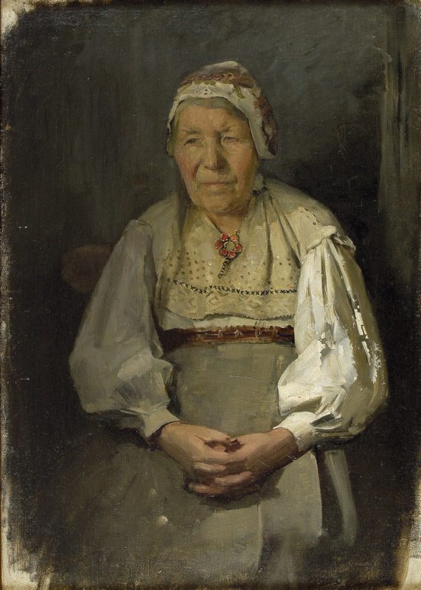
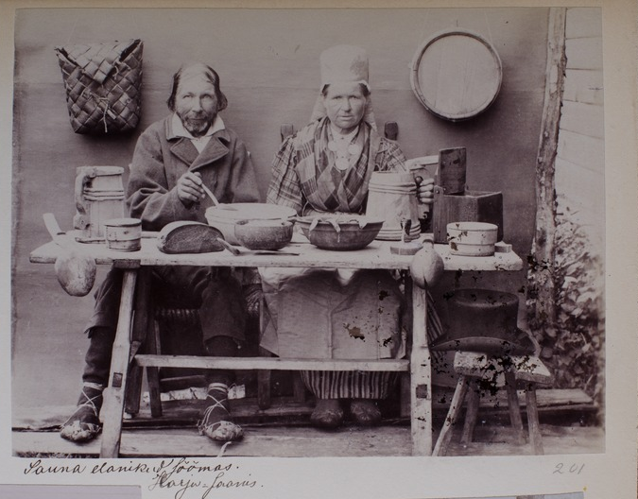
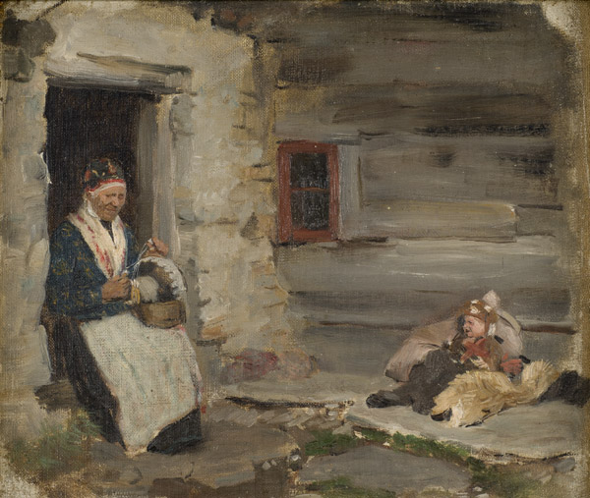
Kristjan Raud, Artist in a Village (1899) works by Paul Raud, 1890s enthographic photos by Estonians, 1980s–1910s
coloniality and hybrid ethnographic identity
– opposition to the coloniser’s culture and adaptation of colonial images, symbols and stereotypes

Slide 8
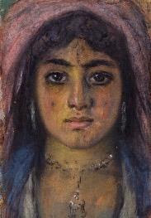
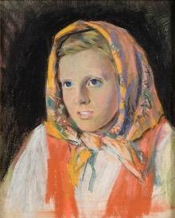
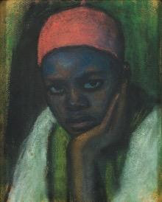
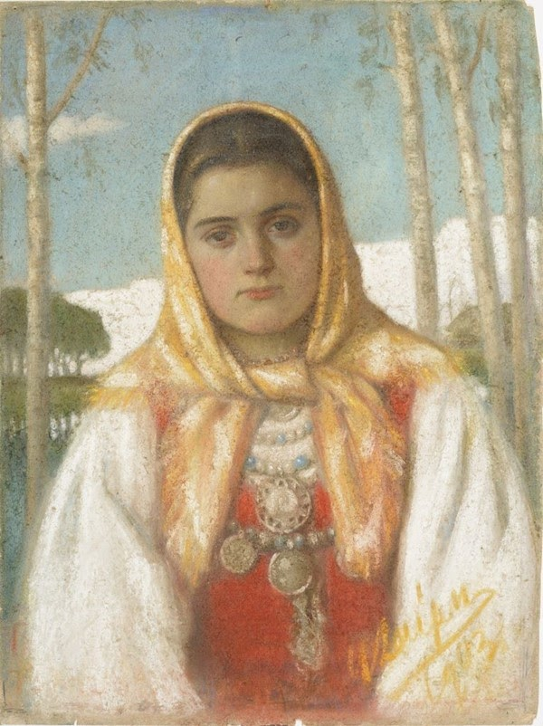
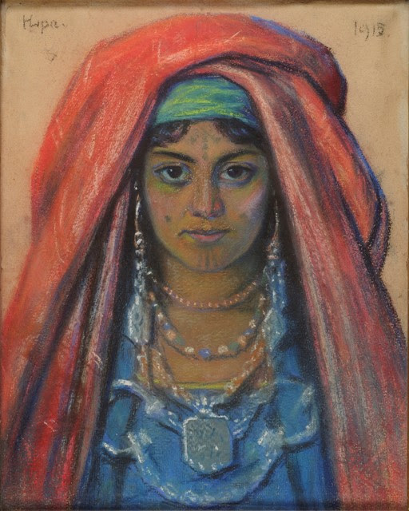
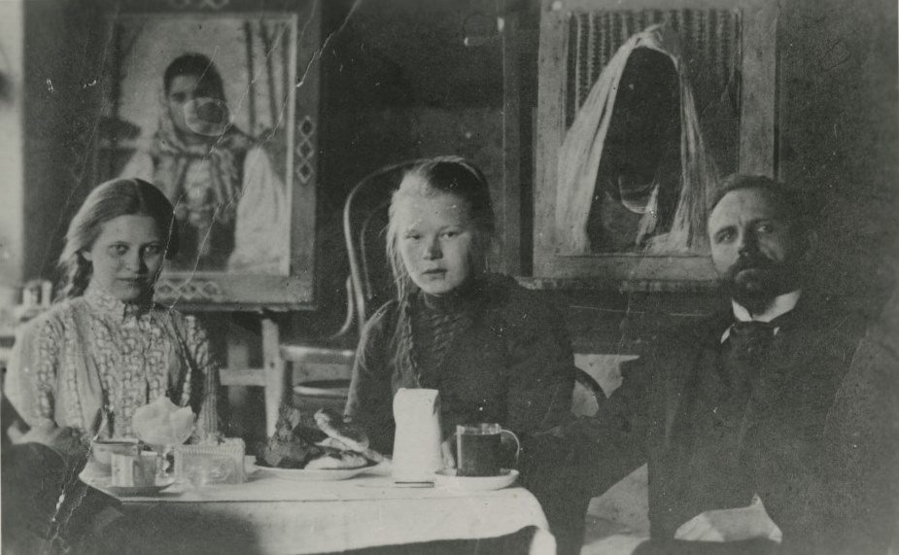
nation building, decolonisation and colonial heritage
Ants Laikmaa’s images of North-Africans and Estonians, 1900s–1910s

Slide 9
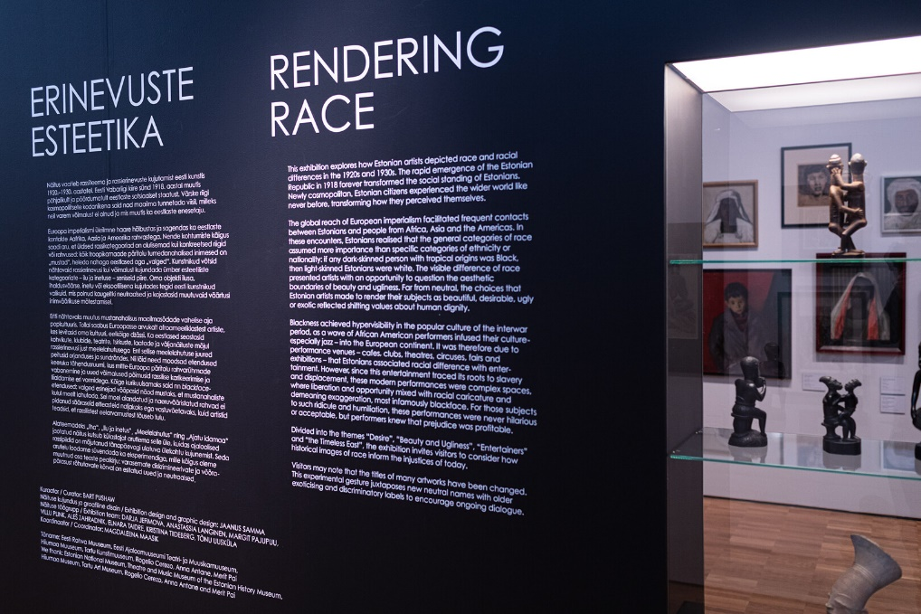
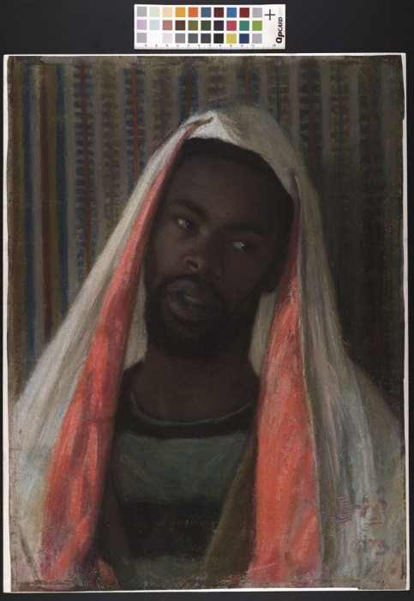
Rendering Race, project space exhibition curator Bart Pushaw (2021)
decolonising the museum
reconstructing links to colonial history and heritage
Ants Laikmaa, Portrait of Samuel Peters (former title: Abessinian) (1903)

Slide 10
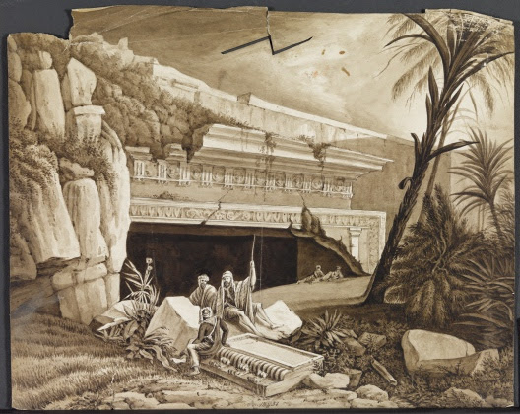
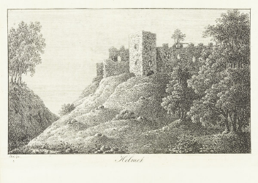
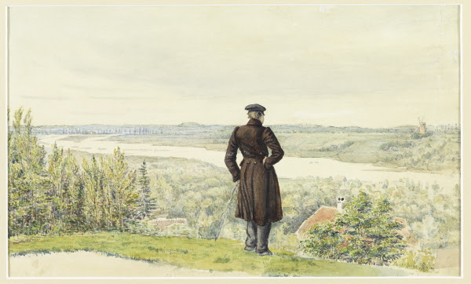
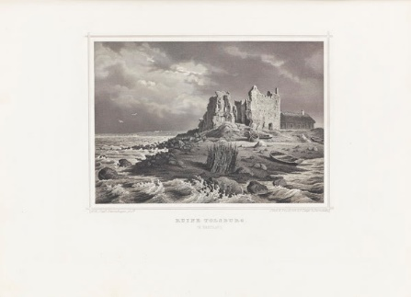
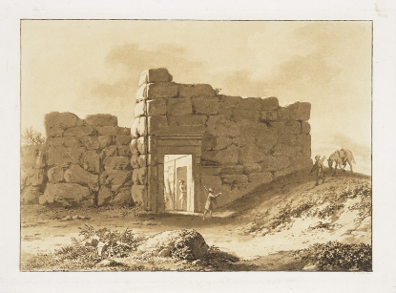
Baltic German and global Ruinenlust
works by Otto Friedrich Pistohlkors, Karl August Senff, Andreas Löwis of Menar, August Pezold (19th century)

Slide 11
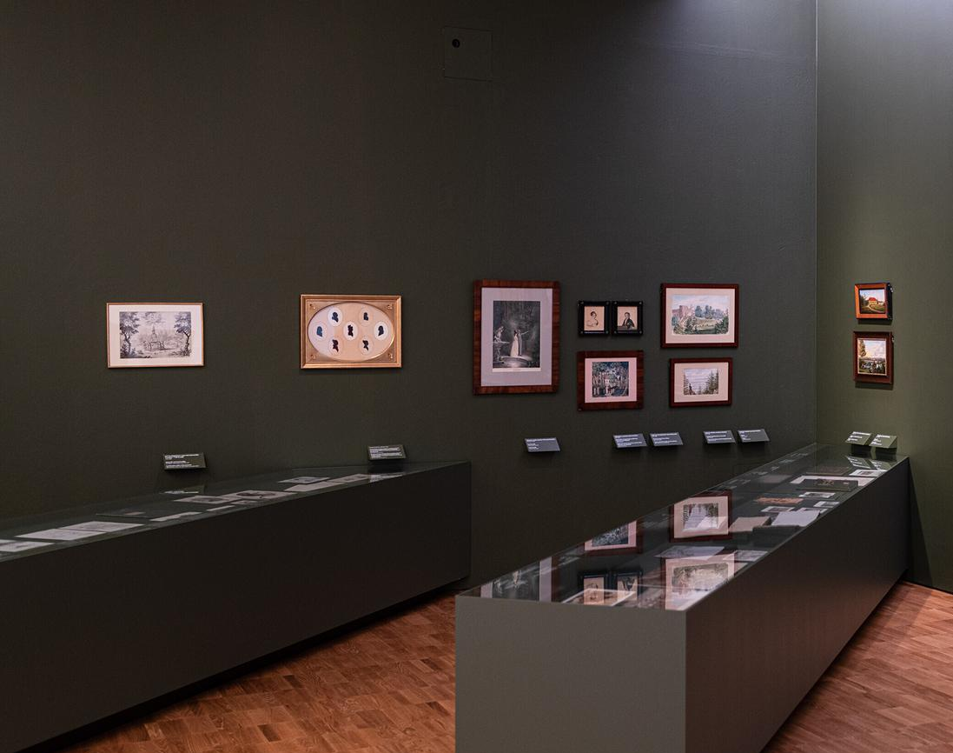
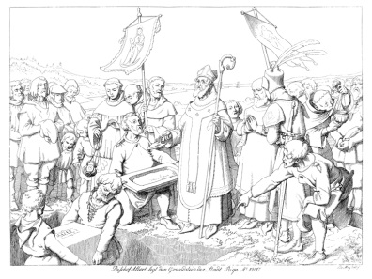
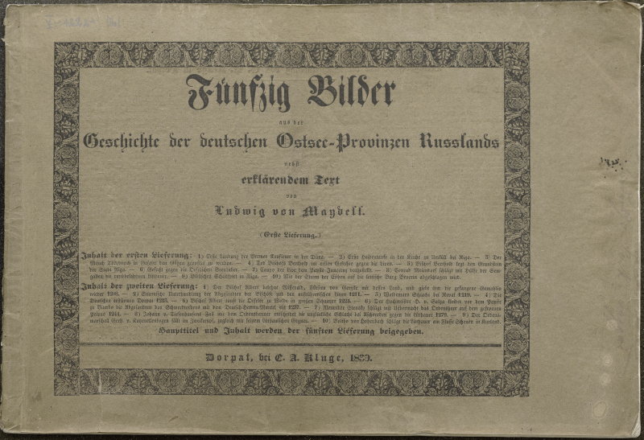
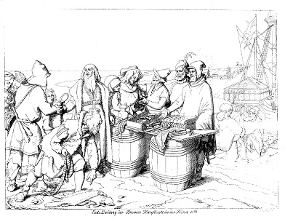
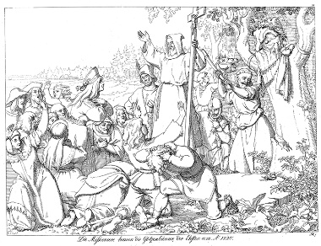
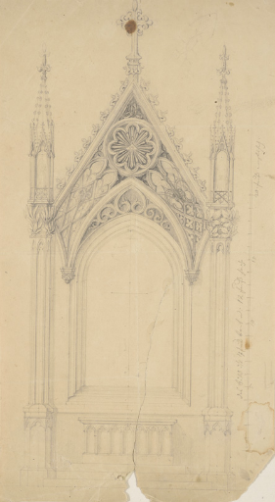
constructing and reconstructing sites of memory visual culture and remediation in other media of cultural memory Friedrich Ludwig von Maydell, Fifty Images from the History of the German Baltic Provinces of the Russian Empire (1839, 1842) reconstruction designs for the St. Olaf Church in Tallinn Old Town

Slide 12
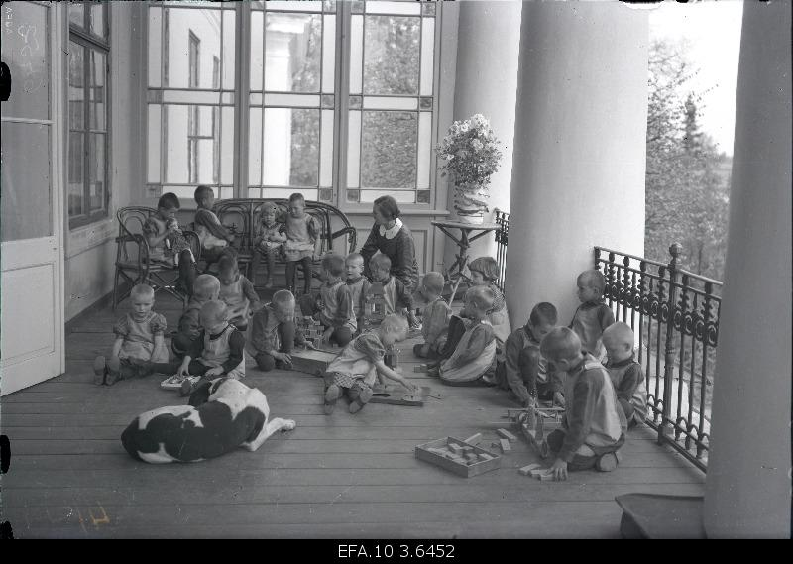
orphanage in a former Baltic German manor estate (1921)

Slide 13
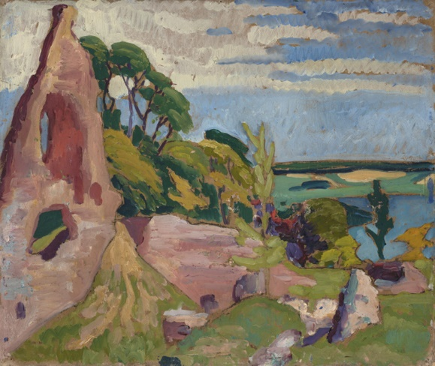
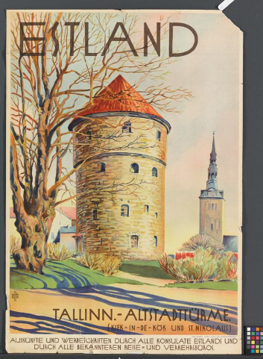
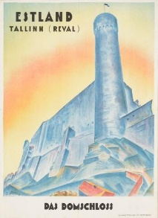
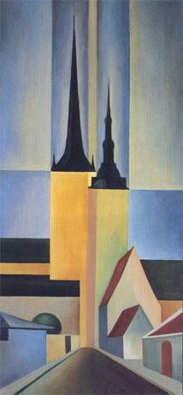
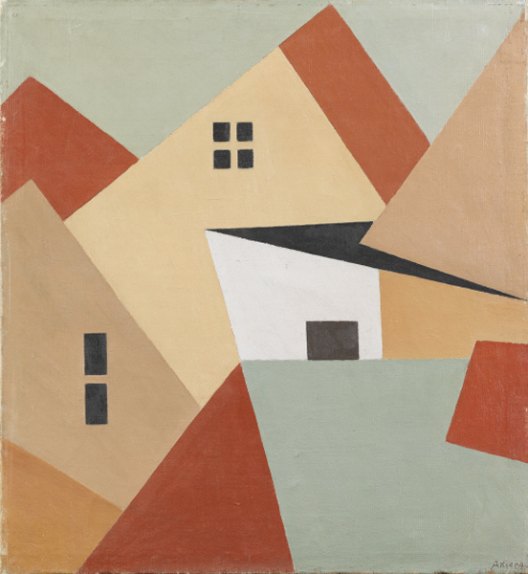
domesticating Baltic-German heritage in the interwar-republic
works by Konrad Mägi, Märt Laarman, Arnold Akberg, Peet Aren

Slide 14
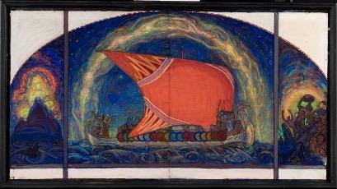
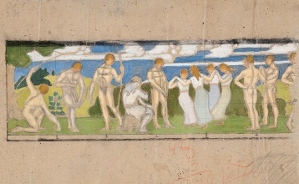
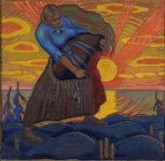
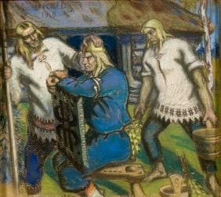
transnational national romanticism – reconstructing the precolonial golden age
1900s–1910s works by Nikolai Triik, Oskar Kallis, Aleksander Uurits

Slide 15
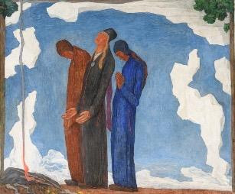
authoritarianism of the 1930s and the return of the ancient (militant) heritage
Kristjan Raud, Victim (1935), Death of Kalevipoeg (1935)
Otepää hillfort, 1930s

Slide 16
art and science Denkmal and Naturdenkmal
works by August Matthias Hagen
teacher at the drawing school of the Imperial Tartu University (1838–1851)

Slide 17
glacial erratic boulders – entangled and re-mediated monuments
Gregor von Helmersen – 1879 call to protect glacial boulders
Julie Hagen Schwarz, Käsmu (1889) brand Estonia (2016–2017)

Slide 18
ethnology and authoritarianism
Alexander Schlater, Rye Harvesters (19th century)
Richard Uutmaa, Rye Harvesters (1941)

Slide 19
heritage, trauma and terror
Ado Vabbe, Demon (1944)

