Slide 1
15th Annual Conference of the
European Heritage Heads Forum (EHHF)
Tallinn, September 8th, 2021
ANNUAL REPORT of the
EUROPEAN HERITAGE LEGAL FORUM (EHLF)
Assessor iuris Wolfgang Karl Göhner
European Heritage Legal Forum (Chair)
German National Committee on Cultural Heritage (DNK)
Bavarian State Conservation Office (BLfD)

Slide 2
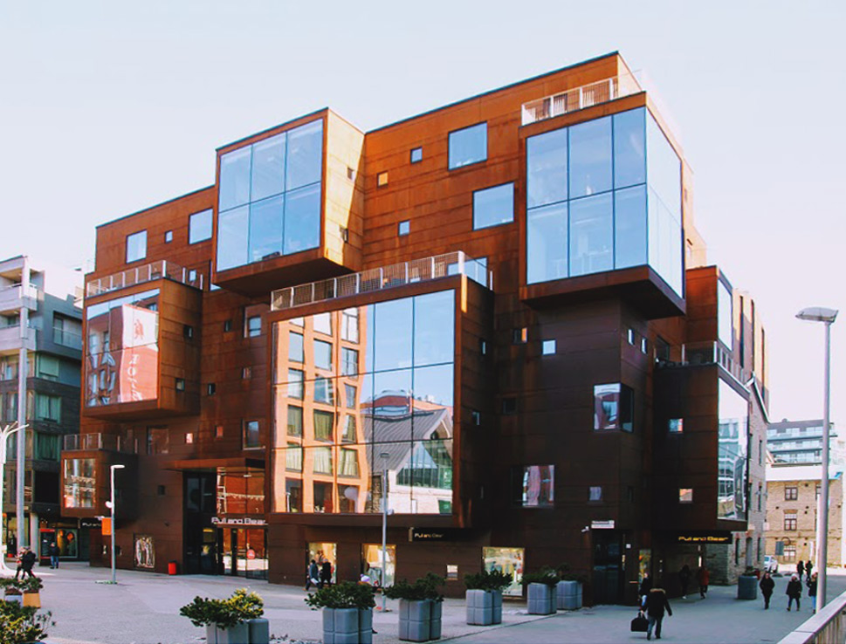
Venue of the 12th Full meeting of the European Heritage Legal Forum (EHLF) on September 8th, 2021 at the Governance Academy, Rotermanni 8, 10111 Tallinn:
© Tallinn, Rotermanni, 8 — Photo — Domofoto - https://domofoto.ru/photo/111077/

Slide 3
Agenda:
TOP 1: Country reports: international, national, regional or local topics with interest of (most of) all EHLF-members
TOP 2: EHLF report to the 15th EHHF Annual Conference on September 8th-11th, 2021
TOP 3: EU Green Deal / EU Renovation wave (with e. g. the „Revision of the Energy Performance of Buildings Directive 2010/31/EU”) / European New Bauhaus
TOP 4: Council Directive 2006/112/EC of November 28th, 2006 on the common system of value added tax
TOP 5: DIRECTIVE 2007/60/EC OF THE EUROPEAN PARLIAMENT AND OF THE COUNCIL of October 23rd, 2007 on the assessment and management of flood risks (report by Ioannis KAVVADAS, DG ENV, European Commission „The Floods Directive: topic ‚Strengthening Cultural Heritage Resilience for Climate Change‘“
TOP 6: Revising the Norwegian Cultural Heritage Act („Lov om kulturminner or kulturminneloven“; see annex): „best practice“ from other countries?
TOP 7: Cross-over discussion about „The new Norwegian approach: working through alliances in Norway“
TOP 8: Rights for owners of CH-buildings or sites, in the different CH legal acts: f. e. right on funding, but also on practical advice in renovating and restoring?
TOP 9: Final Discussion, Conclusions, Acknowledgement and Farewell

Slide 4
Annual EHHF Report 2020 (2021):
European Heritage Legal Forum (EHLF) p. 17

Slide 5
From direct lobbying in the EU
TO WORKING WITHIN YOUR MANDATE FROM YOUR OWN COUNTRY - IN COOPERATION WITH NATIONAL ALLIES

Slide 6
CONVINCING EU TO CULTURAL HERITAGE FRIENDLY REGULATIONS THROUGH LOBBYING
IS NOT AN EASY TASK FROM A ADVISER/SENIORADVISER POINT OF VIEW! (OF COURSE THUS; EHLF):
KEEP TRACK OF NEW AND ONGOING EU - REGULATIONS
USE A FOREIGN LANGUAGE
LACK THE MANDATE TO LOBBY DIRECTLY
AND AT THE SAME TIME KEEP UP WITH ALL THE REST OF YOUR TASKS AT WORK
NOT KNOWING IF YOUR COUNTRY WILL BE AFFECTED BY THE DIRECTIVE AT HAND

Slide 7
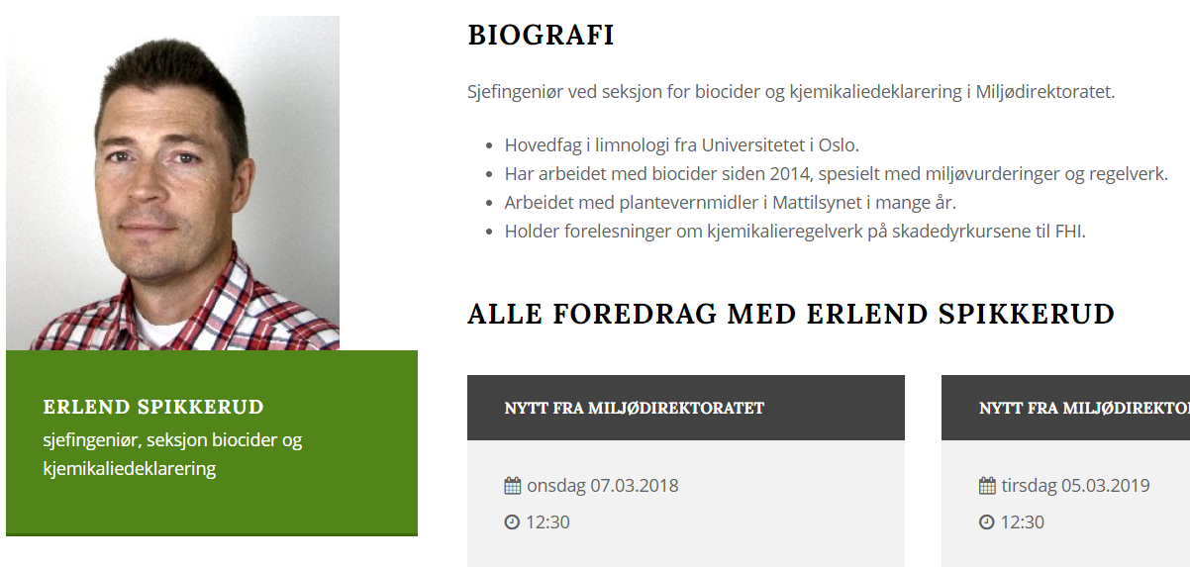
ADVICE TO MORE EFFECTIVE WORK:
FIND YOUR NATIONAL HEROES – EXAMPLE REACH - REGULATION
THERE MIGHT BE PAIRS IN YOUR COUNTRY, ALREADY WORKING WITH MAKING AND DESIGNING EU - REGULATIONS
EXAMPLE NITROGEN
I didn’t know that Norway is suggesting chemicals onto the REACH – directive from the Norwegian Chemical Agency. And that we could inspire them to take CH into account, from the get-go, in their legislative work. To do that we need….

Slide 8
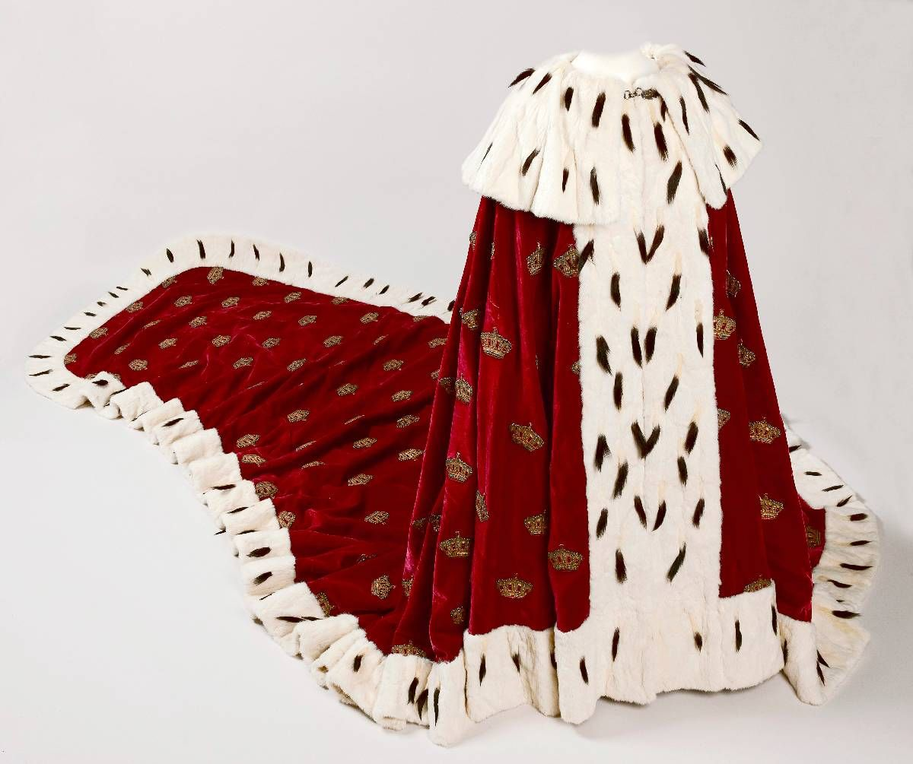
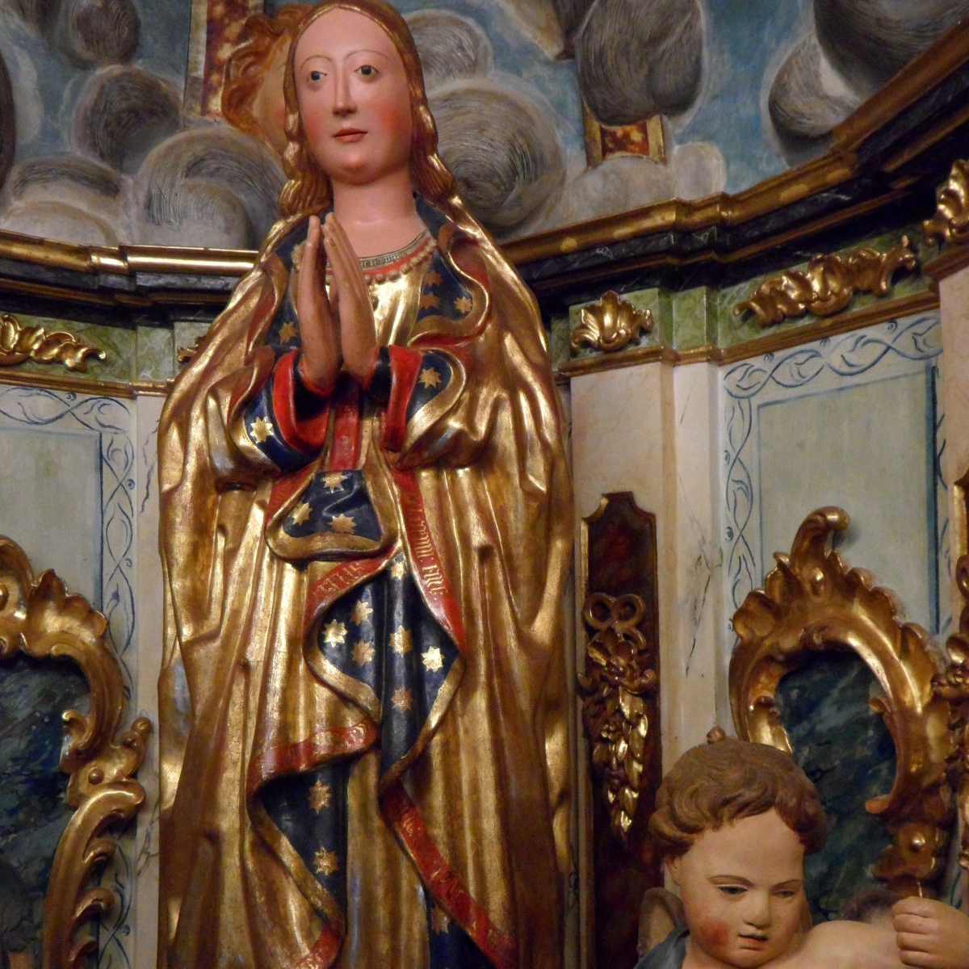
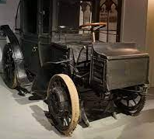
To do that we need….
TO GIVE THEM A BASIC UNDERSTANDING OF WHAT VALUES IS AT STAKE (
TO HAVE THE KNOWLEDGE AND COMPETANCE TO PROVIDE SATISFACTORY REASONS FOR EXCEMPTIONS FROM THE STANDARD – REGULATIONS
FOR THIS CONNECT TO OR HAVE INHOUSE THE NECESSARY CRAFT - COMPETENCE
TO BUILD RELATIONS CROSS - SECTOR IN YOUR OWN COUNTRY

Slide 9
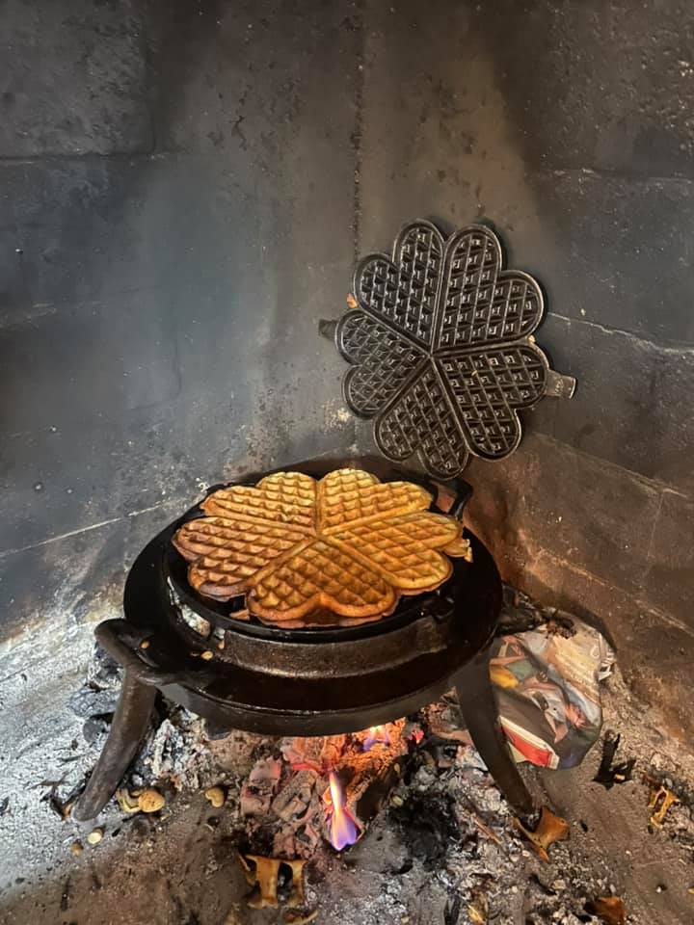
THIS METHOD WILL WORK FOR ALL DIRECTORATES IN ANY FIELD.. (BUILDING; ENERY, FLOOD ETC)
YOU ARE DEPENDENT UPON INVESTED PAIRS AND COOPERATIONS ( IF ALL ELSE FAILS – TRY NORWEGIAN WAFFELS!)

Slide 10
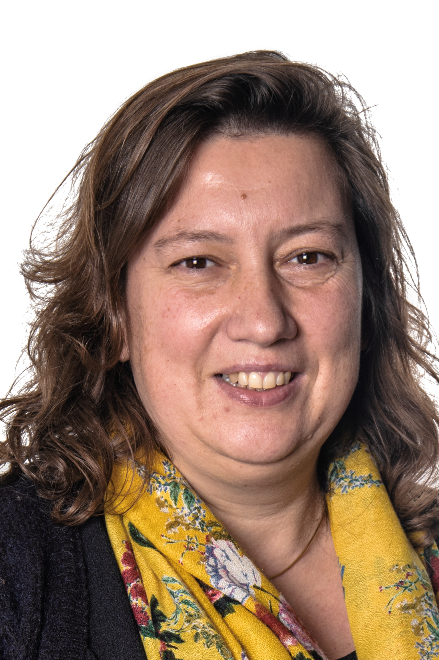

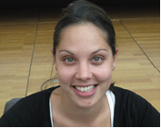
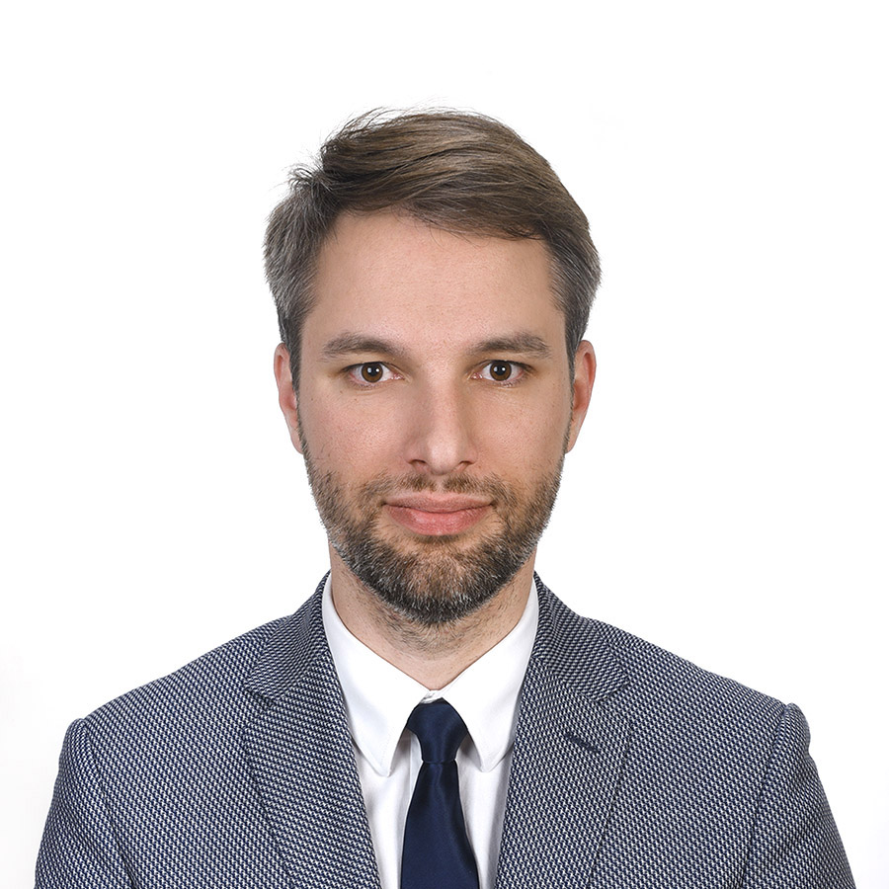
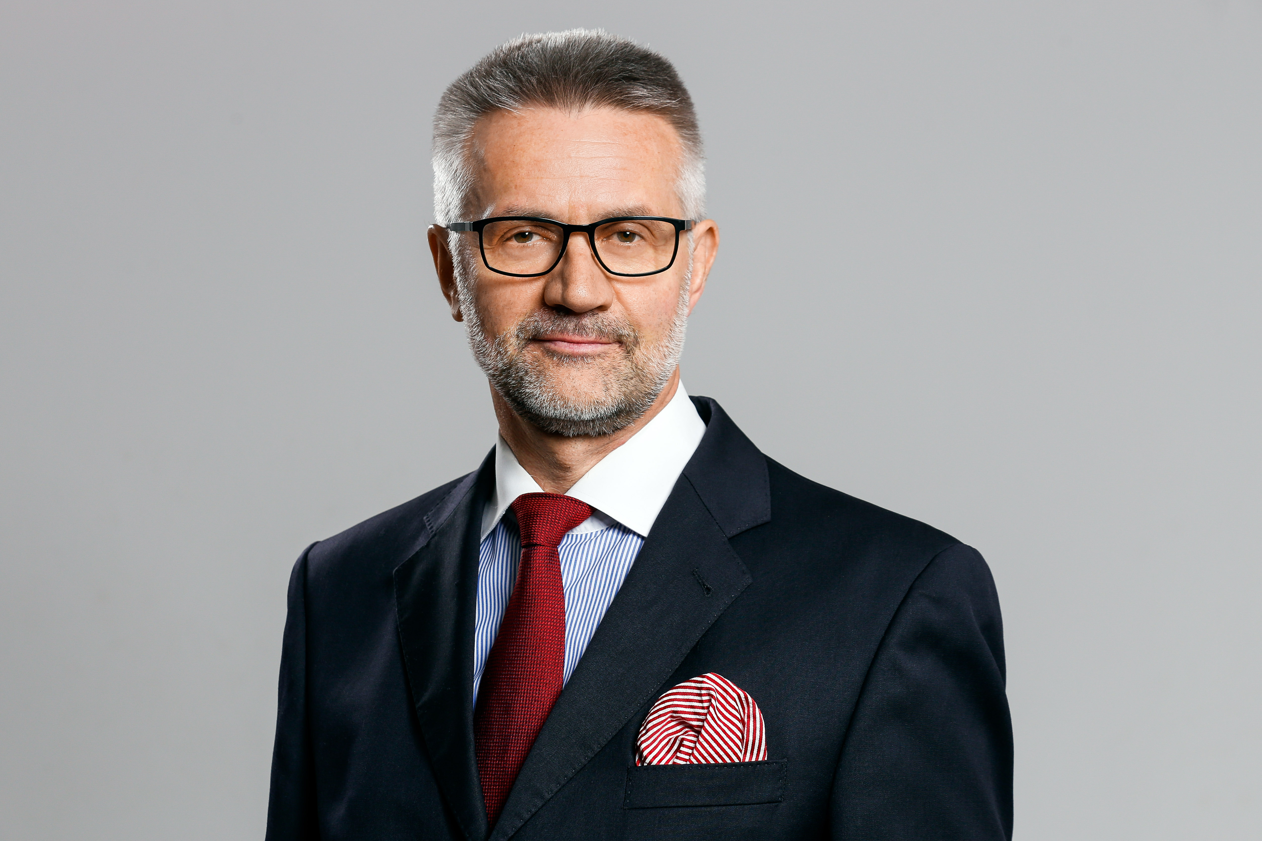
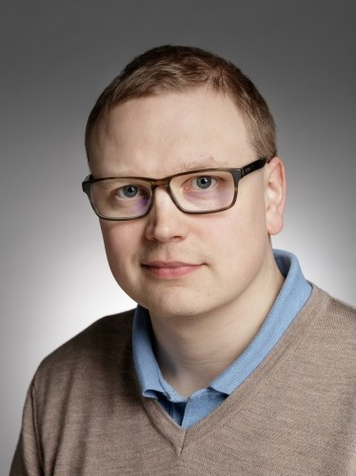
Essentials to report:
(Re-) Election* of the Members and the Chair of the EHLF Secretariat
Vera Ameels
Belgium (Flanders)
Tove Elise Ihler *
Norway
Alexandra Warr-Coxen
United Kingdom (England)
Jacek Buonaventura Brudnicki
Poland
Wolfgang Karl Göhner
Germany
Chairman
Juha Maaperä *
Finland

