Slide 1
Task Force on Economy and Statistics
Tallinn, 9th September 2021

Slide 2
Taskforce members and activities
13 EHHF members: Austria, Belgium-Flanders, Belgium-Brussels, England, Finland, Hungary, Italy, the Netherlands, Norway, Romania, Slovakia, Slovenia and Sweden
2019 ESPON Study „HERITAGE - The Material Cultural Heritage as a Strategic Territorial Development Resource: Mapping Impacts Through a Set of Common European Socio-economic Indicators” published (https://www.espon.eu/cultural-heritage)
2020 start of ESPON Study „HERIWELL_ Cultural Heritage as a Source of Societal Well-being in European Regions“ (https://www.espon.eu/HERIWELL)
2020 several email-correspondences and newsletters
2021 two online meetings

Slide 3
ESPON HERIWELL
850.000 € and started in April 2020
Influence of tangible and intangible cultural heritage on societal well-being
quantitative pan-European analysis on available and comparable Eurostat data and big data.
how the Covid19-Crises influences Cultural Heritage
https://www.espon.eu/HERIWELL
taskforce asked by ESPON to give advices

Slide 4
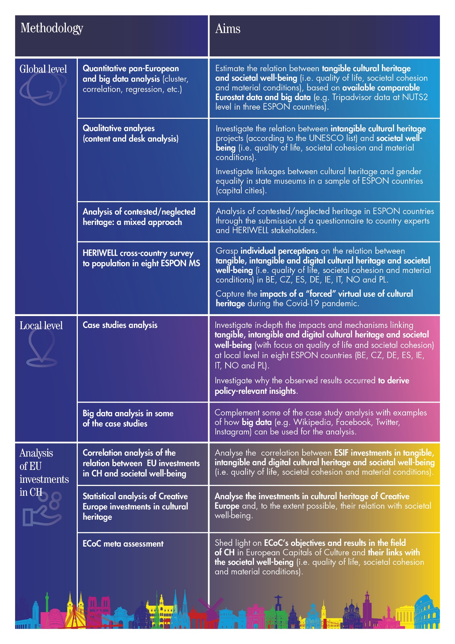
Source: https://www.espon.eu/HERIWELL: 2nd interim report

Slide 5
Preliminary results for linkage betewwn heritage and indiviudal perception of well-being
Asked over 8.000 people in 8 countries about impacts of COVID-19 on their Cultural Heritage behavior and use:
35 % sadness to the impossibility to participate in Cultural Heritage
Higher interest in Seeing Cultural Heritage in their own country/region: 20%
Higher desire to engage more (volunteering, donations,…): 8 %

Slide 6
some conclusions
Lack of comparable data on European and national level for quantitative studies regarding the economic and societal impact of heritage on society and well-being
Need of strategic partners and make more advertisement/stronger voice for collecting data on different levels (national, European)
Task force as a think-tang (lack of data and studies and questions)
Promoter of new studies on European level

Slide 7
Thank you for your attention!
paul.mahringer@bda.gv.at
P

