Slide 1
16th Annual Conference of the European Heritage Heads Forum (EHHF)
Edinburgh, May 20th, 2021
ANNUAL REPORT of the
EUROPEAN HERITAGE LEGAL FORUM (EHLF)
Assessor iuris Wolfgang Karl Göhner
European Heritage Legal Forum (Chair)
German National Committee on Cultural Heritage (DNK)
Bavarian State Conservation Office (BLfD)

Slide 2
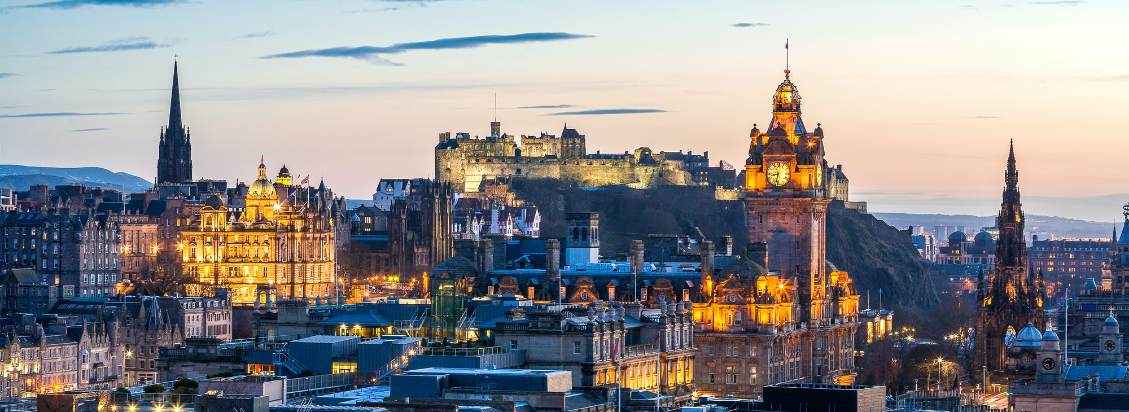
© Edinburgh - https://www.macdonaldhotels.co.uk/destinations/scotland/edinburgh

Slide 3
Annual EHHF Report 09/2021-05/2022:
European Heritage Legal Forum (EHLF) p. ??

Slide 4
CONVINCING EU TO CULTURAL HERITAGE FRIENDLY REGULATIONS THROUGH LOBBYING
IS NOT AN EASY TASK FROM A ADVISER/SENIORADVISER POINT OF VIEW! (OF COURSE THUS; EHLF):
KEEP TRACK OF NEW AND ONGOING EU - REGULATIONS
USE A FOREIGN LANGUAGE
LACK THE MANDATE TO LOBBY DIRECTLY
AND AT THE SAME TIME KEEP UP WITH ALL THE REST OF YOUR TASKS AT WORK
NOT KNOWING IF YOUR COUNTRY WILL BE AFFECTED BY THE DIRECTIVE AT HAND

Slide 5
Annual EHHF Report 09/2021-05/2022:
EU Energy Policy 2030-2050 with the European Green Deal, the "fit for 55" program and the amendments to the Renewable Energy Directive (RED III), the Energy Efficiency Directive (EED) (and Draft Revision 3 of April 27th, 2022) and the Energy performance of buildings Directive (EPBD):
Observing the upcoming consultation deadlines set by the EU Commission.
Informing the members of EHLF and EHHF were providing with model statements drafts.
Clarifying that we urgently need finally an holistic view of everything we do, in all its consequences. This also means that the destruction of existing buildings is catastrophic in several respects:
Climatically,
energetically, because the energy already expended in the building is destroyed,
the rubble must also be disposed of at high energy cost.
In addition, new energy must be expended to construct a new building (“gray energy”).
Ensuring, both factually and legally, that these expenditures are fully "priced in" or evaluated in terms of their environmental compatibility.
Only then there can be any policy change at all that will once again give the building stock the respect it, the people, who once created it, the people, who live inside them, AND the people, who are living “with” these buildings as part of their life, really deserve.
BUT …

Slide 6
Annual EHHF Report 09/2021-05/2022:
Art. 6 para. 2 lit. a) EED-draft: “Member States may decide not to set or apply the requirements referred to in paragraph 1 to the following categories of buildings: (a) buildings officially protected as part of a designated environment, or because of their special architectural or historical merit, in so far as compliance with certain minimum energy performance requirements would unacceptably alter their character or appearance;”
Art. 6 para. 2 lit. a) EED-draft: “Member States may decide not to renovate up to the level provided in paragraph 1: (a) buildings owned by public bodies officially protected as part of a designated environment, or because of their special architectural or historical merit, in so far as compliance with certain minimum energy performance requirements would unacceptably alter their character or appearance”
What will happen in the future to architectural cultural heritage that is protected by the Member States or otherwise of special architectural or historical merit and not owned by the public bodies?
The Solution might be
the change of Chapter II of the EED-draft Rev 3 from “Efficiency in Energy use” to “Exemplary Role of Public Sector”,
the establishment of regulatory primacy for the EPBD,
the reduction of the EED regulations to the exemplary function of public authorities (Art. 6 para. 1 EED draft),
the application of the future Art. 8 EPBD to the building stock alone “when buildings undergo major renovation, the energy performance of the building or the renovated part thereof is upgraded in order to meet minimum energy performance requirements set in accordance with Article 54 in so far as this  that  is technically, functionally and economically feasible.”,
therefore the new EED provisions do not apply to the non-renovated building stock.

Slide 7
ADVICE TO MORE EFFECTIVE WORK: FIND YOUR NATIONAL HEROES – EXAMPLE REACH - REGULATION
THERE MIGHT BE PAIRS IN YOUR COUNTRY, ALREADY WORKING WITH MAKING AND DESIGNING EU - REGULATIONS
EXAMPLE NITROGEN
I didn’t know that Norway is suggesting chemicals onto the REACH – directive from the Norwegian Chemical Agency. And that we could inspire them to take CH into account, from the get-go, in their legislative work. To do that we need….

Slide 8
Annual EHHF Report 09/2021-05/2022:
The EHLF :
informed about the very strong protest against a planned and upcoming EU ban on lead, the impact on the production, restoration and presentation f. e. of stained glass windows,
dispatched a call from the field of glass restoration,
produced a model statement in english language related to this,
immediately pointed out that the protection and conservation institutions on monuments and archaeological sites of Europe should have to deal with the topic in a holistic manner, taking into account the holistic nature of our European monuments, culturally valuable buildings and sites.
BUT …

Slide 9
Annual EHHF Report 09/2021-05/2022:
BUT in view of the mostly very justified complaints of the cultural heritage sector vis-à-vis other "concerns" should we not correspondingly consider that vice versa
the problem is indeed much more comprehensive than just the lead glazing mentioned in the loud protests?
Objectively, one will hardly be able to deny that lead (and its compounds) is not entirely harmless.
The entry in the annex list will therefore probably come.
In our opinion, however, this should not result in a ban, but "only" in an approval obligation for manufacturers and importers (and ultimately also for users).
We also consider a general ban on lead to be very difficult to enforce, since lead alone is of too great interest to various branches of industry.
In addition, lead sulfate and lead carbonate have been on the REACH annex list for a long time, yet it is still possible to buy artists' paints containing lead if it is officially confirmed that the buyer will only use the paint for restoration or similar purposes and that the pigment cannot be replaced for technological reasons.
In general, there are exemptions for "paints for artists" for numerous substances. The list entry for lead sulfate and lead carbonate, for example, reads: "However, Member States may, in accordance with the provisions of International Labour Organization (ILO) Convention 13, permit the use on their territory of the substance or mixture for the restoration and maintenance of works of art and historic buildings and their interiors, as well as the placing on the market for such use. Where a Member State makes use of this derogation, it shall inform the Commission thereof." (s. REACH, ANNEX XVII No. 16 & 17)
For some other substances, there are exemption notes "for professional users only" - that would probably be manageable in this case, too, in the areas of cultural heritage, but also the arts as well.

Slide 10
Essentials to report:
Members and the Chair of the EHLF Secretariat
Vera Ameels
Belgium (Flanders)
Tove Elise Ihler
Norway
Alexandra Warr-Coxen
United Kingdom (England)
Jacek Buonaventura Brudnicki
Poland
Wolfgang Karl Göhner
Germany
Chairman
Juha Maaperä
Finland

