Slide 1
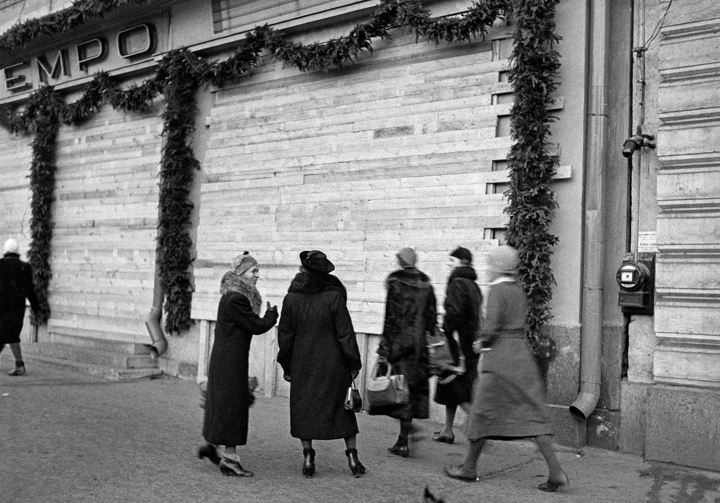
EHHF VIRTUAL FIKA 1.2.2023
News from Finnish Heritage Agency
Protection preparedness in Helsinki 10.12.1939,photo Hugo Sundström, Finnish Heritage Agency, Jounalistic photo archive, Hufvudstadbladet (JOKAHBL3B_J04:2)

Slide 2
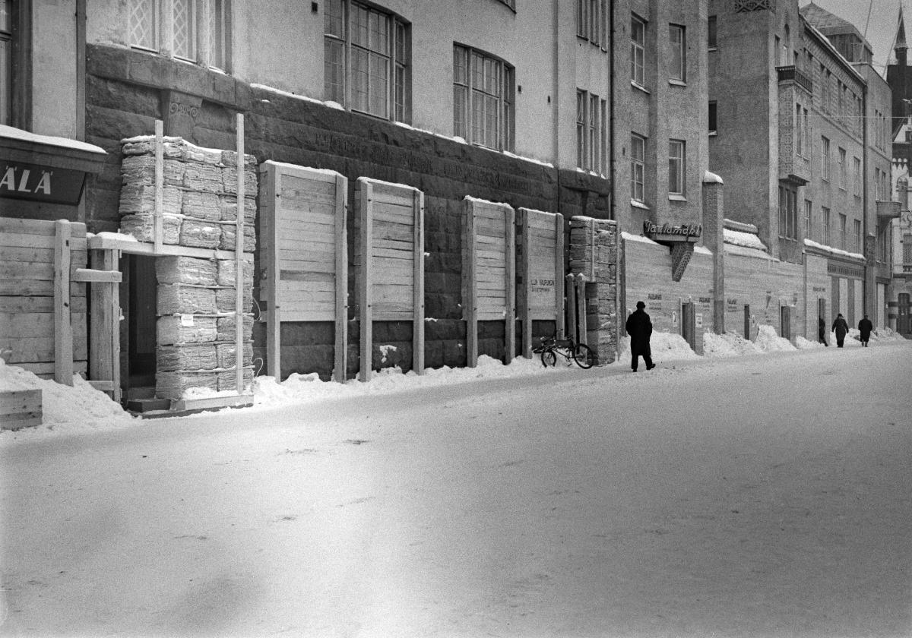
SUPPORT TO UKRAINE
One delivery of conservation and protection materials delivered to Lviv in collaboration with Finnish National Gallery, Forum Marinum and National Museum in Stockholm + consultation with conservators and management
Second delivery is being prepared in FHA, coordinated by Ministry of the Interior in collaboration with Ministry of Culture in Ukraine (based on the request for equipment supply); well functioning channel and process for transportation of materials through European Union Civil Protection Mechanism, applys also to cultural heritage.
Buildings protected against bombing in Oulu January 1940, Finnish Heriatge Agency, Jounalistic photo archive, Kaleva (JOKAKAL3B:6047)

Slide 3
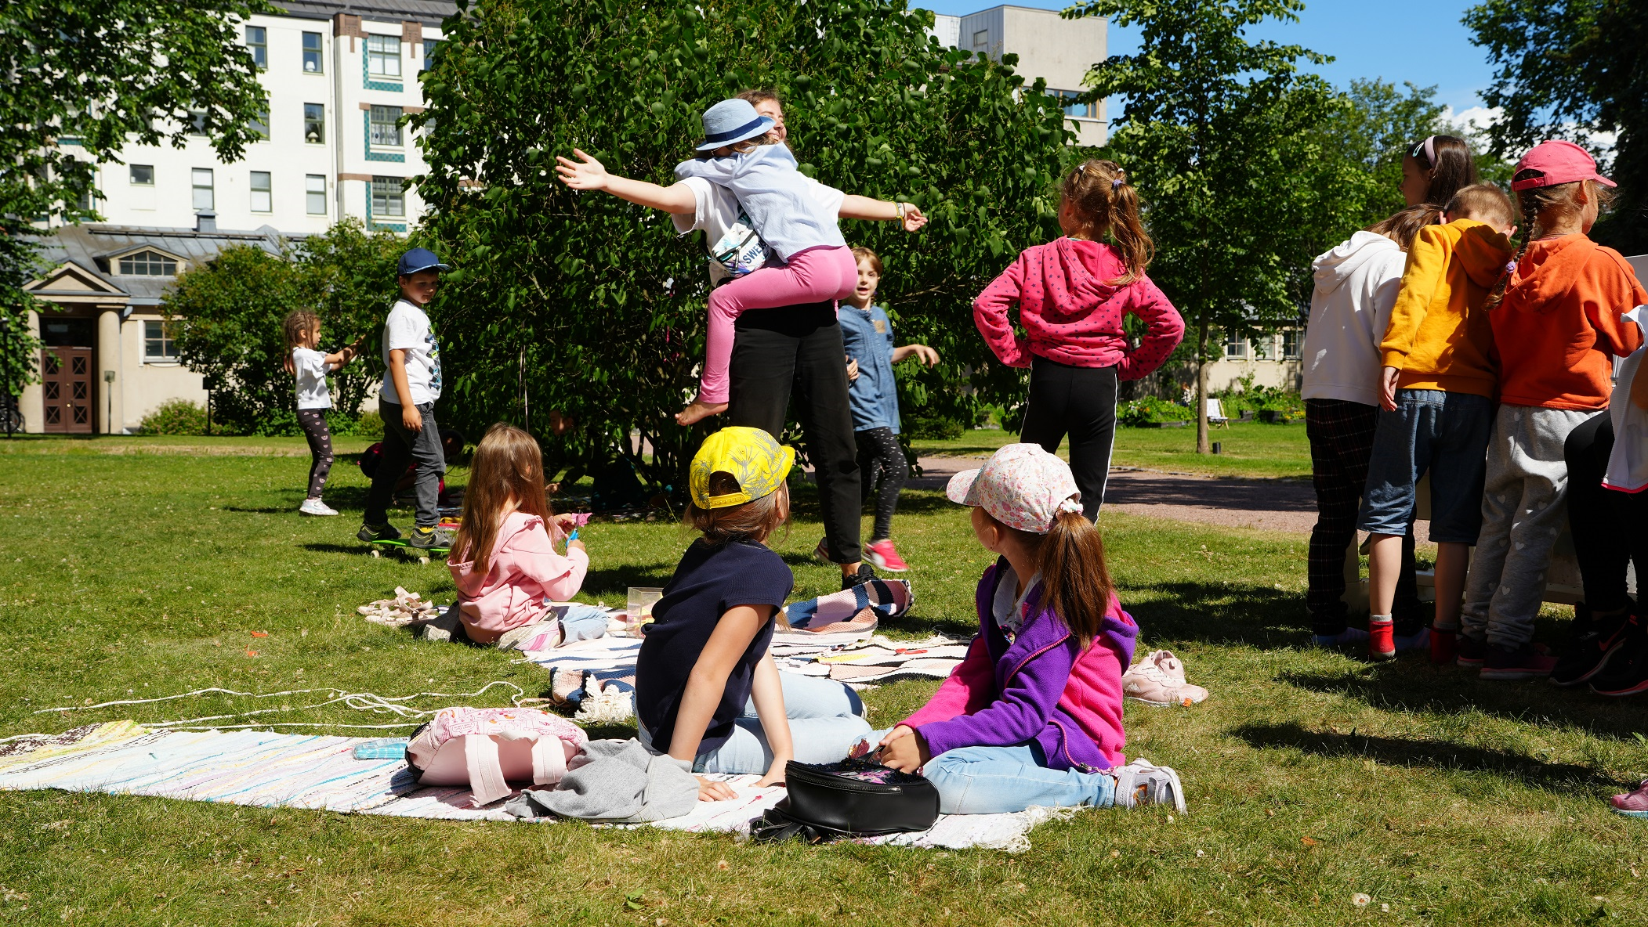
Photo exhibition in collaboration with Helsingin Sanomat –news company combining new press photos and journalistic archive photos about Ukraine and Ukrainian culture in FHA’s collection
2 summer camps at the National Museum of Finland for 180 Ukrainian refugee children in collaboration with Swedish Beredskapslyftet and supported by several companies & associations.

Slide 4
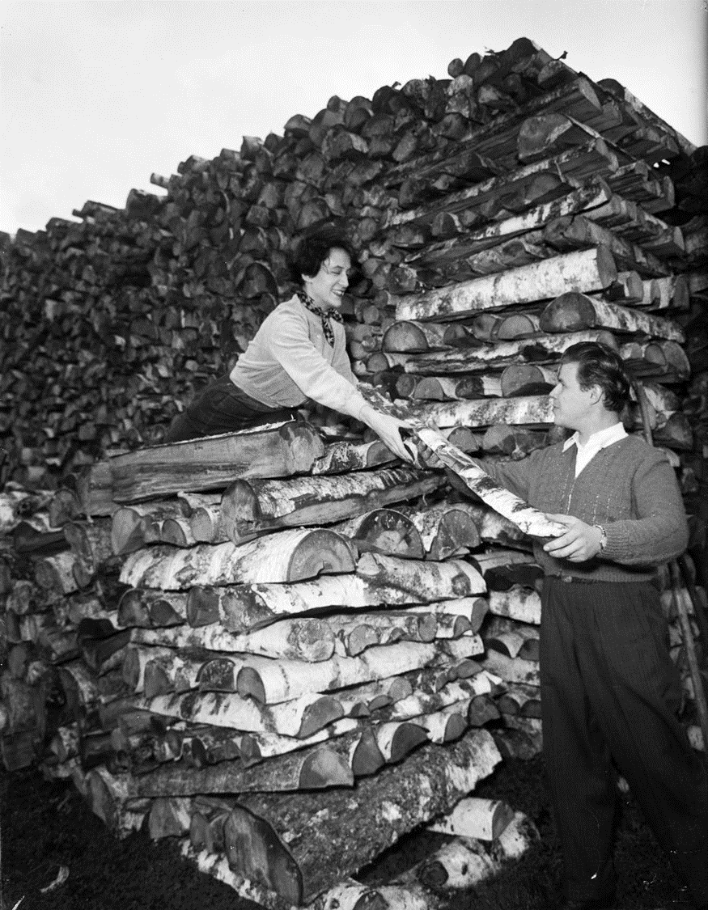
ENERGY CRISIS
Efficient actions to save energy in all properties, public and private: lowering the room temperatures with 1-2 degrees; public information; mild winter -> electricity comsumption savings -8%!
Self-suffiency in energy production rising in Finland (wind, Olkiluoto 3 nuclear power plant)
PREPAREDNESS
an overall theme in our work since February. FHA working with our role and responsibilities in preparedness & cultural heritage
Funding from Ministery of Education and Culture for a pilot project to develop a systematic model of 3D modelling of built heritage
The Hague Convention: finishing and updating the national listing of valuable heritage for the government desicion of principle.
Kuva: U A Saarinen 1953, MV, JOKA Journalistinen kuva-arkisto, UA Saarisen kokoelma.

Slide 5
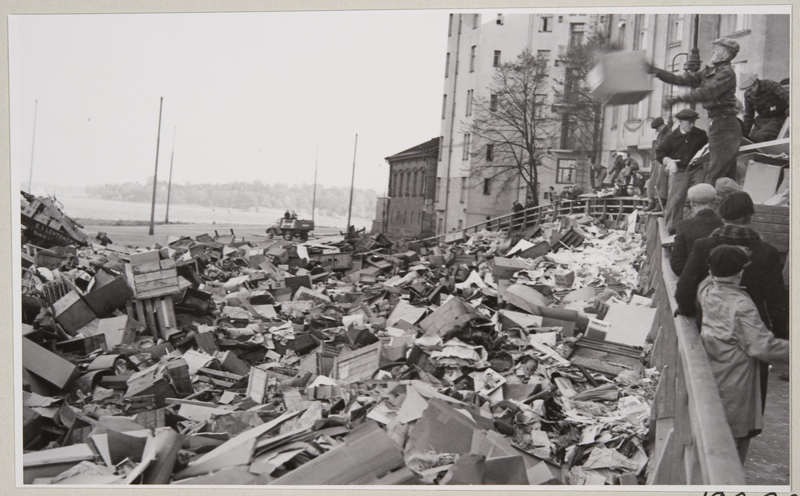
Other news:
The cooperation model for comprehensive security in Finland is internationally unique and respected. It’s a model for collaboration in preparedness for public authorieties, businesses, ngos and citizens.
Security Strategy for Society from 2017 lays out vital functions in society, i.e. the basic functions – also cultural heritage - that must be safeguarded under all conditions and at all operative levels. https://turvallisuuskomitea.fi/wp-content/uploads/2018/04/YTS_2017_english.pdf
-> our goal to strengthen the role of cultural heritage as part of the mental and psychological resilience in the society as well as get a clear mandate and recognition and even some resources as an official actor and agency in this field.
Parliament elections in April; proposals for enhancing preparedness in heritage given to government program through the Ministry of Education and Culture.
Cleaning of the attics in Helsinki, October 1939, Finnish Heritage Agency, historical collections. Hufvudstadsbladet (HK19391118:5).

