Slide 1
Introduction to the CHARTER Alliance
Lluís Bonet, University of Barcelona. CHARTER project Coordinator
27 March 2024 EHHF online meeting

Slide 2
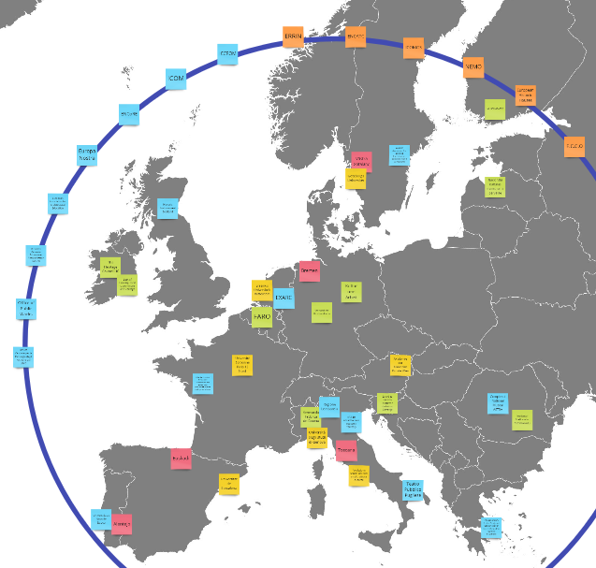
CHARTER Cultural Heritage Actions to Refine Training, Education and Roles
A European alliance among 4 key stakeholders
1. The education and training providers that seek to improve clarity on curricula provision, types, levels and delivery routes to promote quality in learning outcomes, equivalence and mobility.
2. The industry that wish to be certain of the availability of high-quality expertise, distributed regionally to facilitate the sustainable access, use and promotion of cultural heritage
3. Public bodies and agencies that need to articulate policies that safeguard, sustain and promote cultural heritage for the common good by resourcing the transmission of skills
4. Cultural Heritage professionals that seek recognition for their roles and mission as these relate to experience, expertise and professional qualification.
THE CHARTER CONSORTIUM
(47 members):
21 full members:
- 7 leading academic/training org.
- 8 employer and policy maker org.
- 6 European/International networks
7 affiliate members
- 5 (+1) regions
- 2 institutional bodies
19 associate partners, representing a wide spectrum of the Cultural Heritage field and European regions
10 Expert Advisory Board members

Slide 3
Mission and objectives of the CHARTER project
CHARTER identifies skills shortages and mismatches in the cultural heritage sector to bridge the gap between education and occupational systems to ensure the sector’s viability and illustrate its contribution to social, economic and environmental sustainability in Europe.
Clarify occupational roles and activities as well as create tools for an integrated and responsive education system.
Identify innovative / emerging curricula and propose specific guidelines to equip education and training professionals to respond to current and future needs for cultural heritage skills and competences.
Analyse challenges and opportunities for the CH sector due to climate change, green transition, transformation to circular economy, digital information and communication technologies.
Structure cultural heritage as an economically active sector. Build a strong and durable Cultural Heritage Skills Alliance

Slide 4
Blueprints for sectoral cooperation on skills:
a means to describe heritage future
2
Strategy design phase:
from the analysis of gaps & needs
1
Research phase
3
Sustainability phase
Professional taxonomies
Regional (and national) CH ecosystems
Job vacancies
Quality standards and certification schemes for VET, LLL and HE
Benchmarking of innovative/emerging curricula
Proposal and application of 6 main CH competence functions
Methodological curricula guidelines for 8 emerging E&T fields
Drivers of change and scenario building
Design of a set of recommendation to key stakeholders
Implementation of a sectoral skills strategy
Launch of the CH skills alliance (policy makers, professionals, educators, students, employers, clients) committed to deploying a sector growth strategy at regional, national and European level

Slide 5
Circular Value Chain
Recognition
Activities necessary to identify and recognise cultural heritage through interpretation, narration, identification and advocacy.
Preservation and Safeguarding
Activities that need to be put into place to ensure the long-term survival and care of cultural heritage, from maintenance to conservation, preventive conservation, restoration, and safeguarding
Engagement and Use
Activities necessary to access and open cultural heritage, make it understandable and available for consultation, raise awareness, and use it as a resource for all stakeholders.
Research and Development/Education
Activities that are necessary throughout the process that go from the recognition of cultural heritage to the preservation and enhancement of cultural heritage.
Management
Activities that go from strategic planning to everyday administration and management.
Governance and Policy-making
Activities related to the decision-making for cultural heritage in the wider domain of cultural heritage policy at local, regional, national and international level.

Slide 6
The Heritage Ecosystem principles
To transmit meaning and values through heritage work, all processes must be embedded in interconnected participatory mechanisms, ensuring a multidisciplinary approach.
Recognition of this leads to a standardised statement of heritage mission and practice to be implemented on all levels, relying on the following principles:
The existential imperative
Meaning and values
The mandate of the heritage sector to deliver public benefit, improving the quality of life
Bespoke platforms
Democratic policymaking
Horizontal management embedded in participatory governance structures
The 6 functional areas
Professional competences
Training and education in heritage at all levels; participation, democratic values, increasing resilience of societies
Change and innovation
Systemic knowledge
exchange
Uphold and implement conventions and policy documents
Notes:
This slide I altered to make the text shorter and clearer. Feel free to change! I am not sure if I understand the last one and have given a useful shorthand (change and innovation)

Slide 7
Development of curricular guidelines for 8 innovative / emerging fields
Community engagement
Sustainability in built heritage and landscape
Revival of traditional crafts and techniques
New heritage preservation
Cultural heritage in the digital environment
Participatory leadership and management
Cultural heritage policy design and regulation
International cultural heritage relations

Slide 8
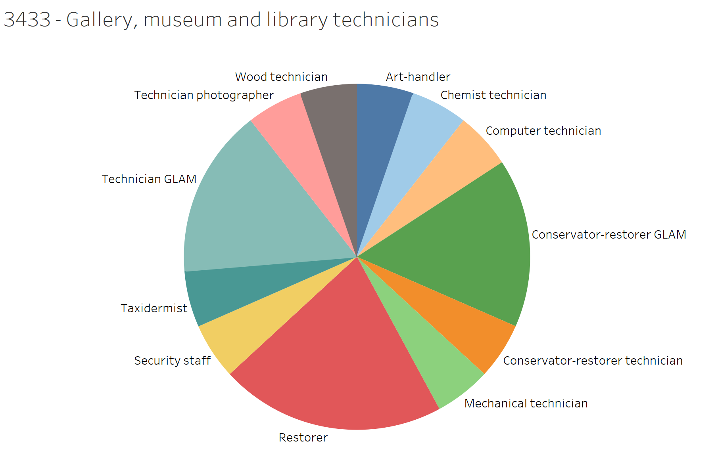
Findings on occupational profile classifications
Main problems:
- Classification systems reflect a narrow and outadated understanding of heritage practice.
- This results in overlapping and incoherence, compromising accuracy, transparency and boundaries of different occupations.
- Current and emerging heritage occupations are not identified as fully or partly cultural for statistics, e.g. archaeologists not fully cultural.
- Leading to inaccurate data analyses of heritage employment and future skills training needs
EXAMPLE: ISCO-08 3433 – Gallery, museum and library technicians [INTERNATIONAL STANDARD CLASSIFICATION OF OCCUPATIONS]

Slide 9
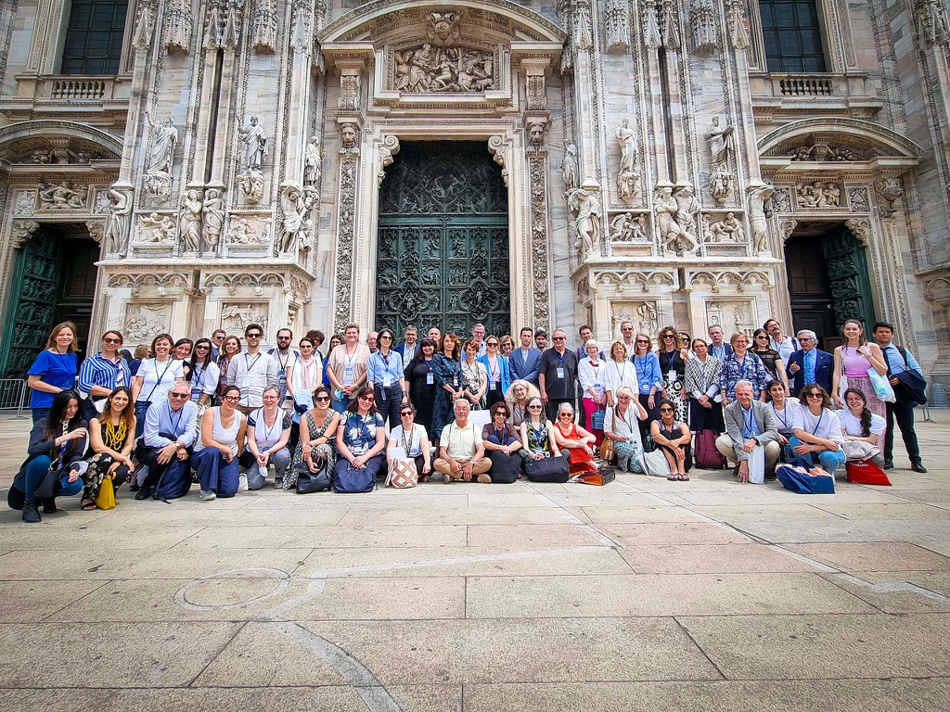
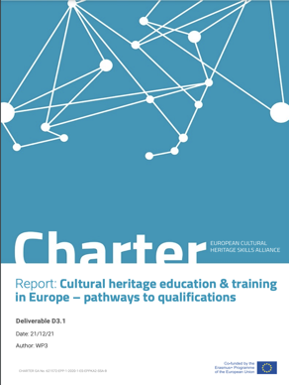
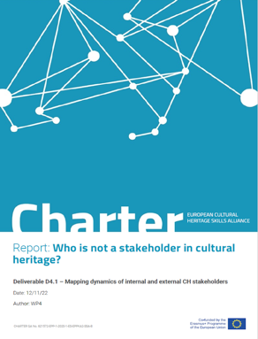
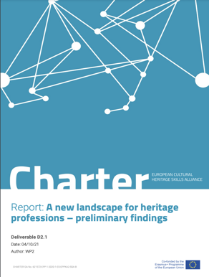
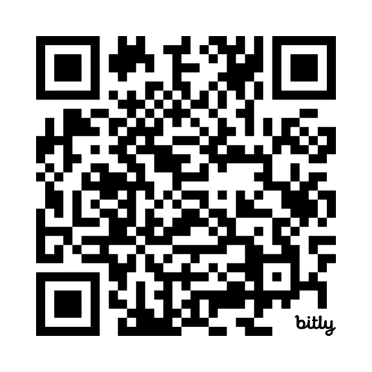
Thank you!
Sign up to the CHARTER newsletter
www.charter-alliance.eu info@charter-alliance.eu

