Slide 1
Access to EU Law
Valentina FRATTO
Publications Office of the European Union
Unit C.2 EUR-Lex and legal information
Directorate C – Access to and reuse of public information
European Heritage Legal Forum Annual meeting
29 April 2024

Slide 2
Outline
EUR-Lex and its content
EU Law in Force
N-Lex
Quick live demonstration
Various types of search results
Navigating through search results and different views
A selection of features and functionalities
Advantages for registered users
Potential of the Help pages

Slide 3
The legal system of the EU in a nutshell
Sources of EU law
EU: unique system and structure
The EU is based on the rule of law
Hierarchy of law: ‘higher level norms’ prevail over ‘lower level norms’
Approved by
all EU countries
Treaties,
CFR*,
gen. principles
Primary law
EU objectives
How decisions are taken and the relationship between the EU and its Member States
Regulations, Directives and Decisions
Secondary law
Puts the objectives & policies into practice
The EU institutions can pass law only in those areas, where its Member States have authorised it to do so, via the EU treaties
Delegated and implementing acts
*Charter of Fundamental Rights of the EU

Slide 4
The role of EU institutions and EU law-making
Main decision-making bodies of the EU:
The European Parliament
- represents EU citizens’ interests
- decides on new actions and law together with Council of EU
- members: 705, directly elected by EU voters every 5 years –
next elections 6-9 June 2024
The Council of the European Union
- represents the interests of EU Member States
- decides on new actions and law together with European Parliament
- members: national government ministers
The European Commission
- represents the general interests of the EU
- proposes new actions and law; ensures the correct application of EU law
- members: a team of Commissioners, 1 from each EU country
European Council
--- Political priorities
European Parliament
Negotiate
and decide
Council of the EU
European Committee of the Regions
Advice
European Commission
European Economic and Social Committee
Proposes new law
Ensures that EU law is enforced and applied in the same way in ___ every country
European Court of Justice

Slide 5
How EU law is applicable in your country: main types of acts
REGULATION
Automatically applicable in all EU countries, in its entirety, as soon as it enters into force.
Example: Regulation on roaming
DIRECTIVE
It sets out an objective that EU countries must achieve but leaves them free to choose how to do so. EU countries must adopt measures to incorporate them into national law (transpose) by a specific date. Example: EU single-use plastics directive
DECISION
Automatically applicable only to those addressed (an EU country or an individual company). Example: Decision on allowing Croatia to adopt the euro on 1 January 2023
Recommendation, Opinion and MORE
For more information on type of acts visit EUR-Lex and Europa websites

Slide 6
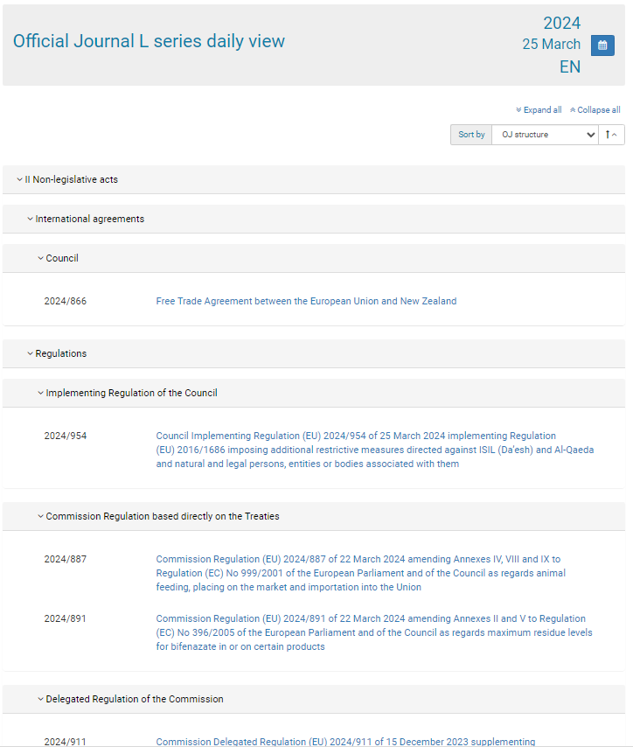
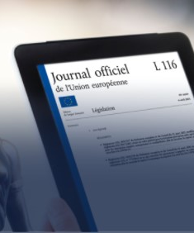
What is EUR-Lex?
Online portal giving access to European Union law
Managed and maintained by the Publications Office of the European Union
Accessible in 24 languages
Free of charge
Constantly updated
More than 1 million documents
Ca 190,000 visits per day
Access to the authentic Official Journal
Since 2013 only the electronic version is legally binding

Slide 7
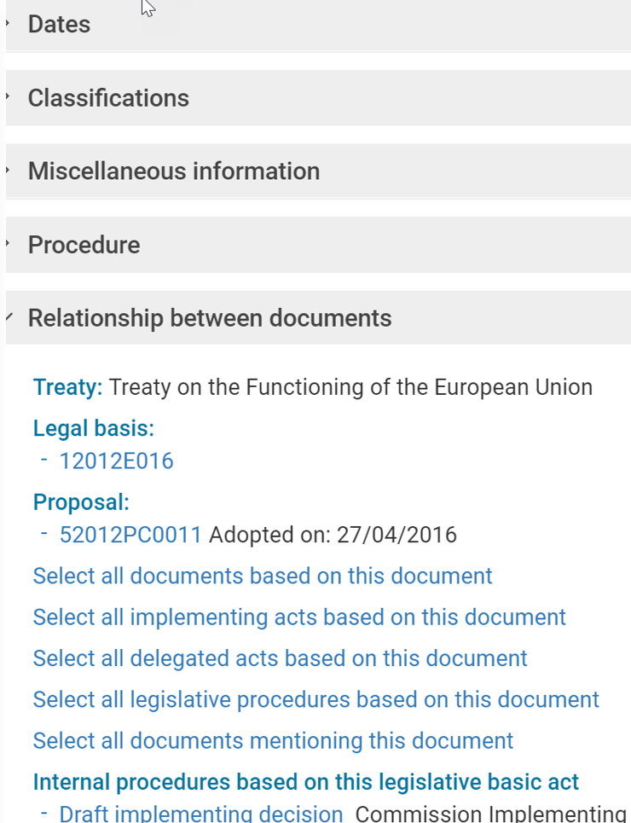
What can you find on EUR-Lex?
Each document is accompanied by analytical information and linked to other documents published on EUR-Lex
Treaties
International agreements
Legal acts
Preparatory documents and information related to legislative procedures
EU case-law
National case-law
National transposition measures
National case-law related to EU law
To facilitate understanding of EU legislation
 Consolidated texts
 Summaries of EU legislation

Slide 8
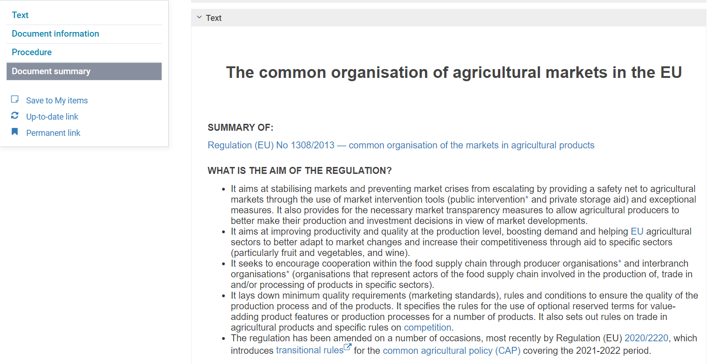
Summaries of EU legislation
Summaries are short, easy-to-understand explanations of the main legal acts passed by the EU – intended for a general, non-specialist audience.
.

Slide 9
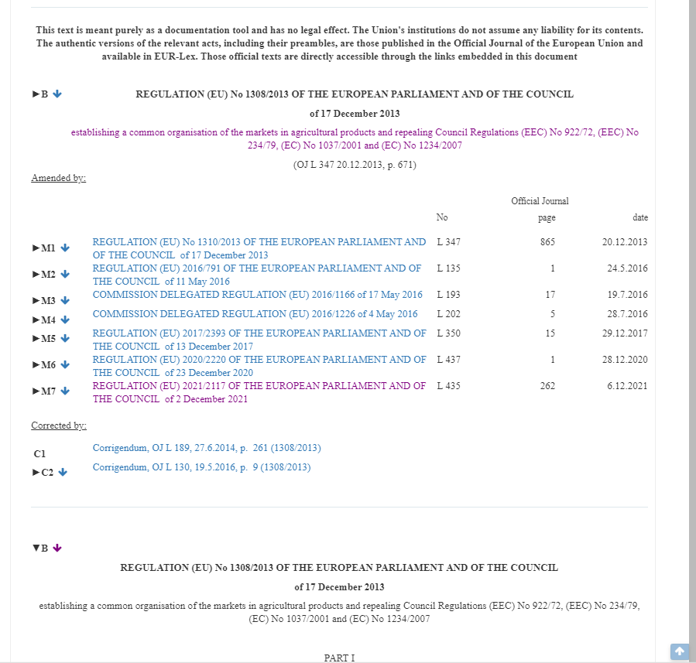
Consolidated texts
Consolidation is the action of combining an initial act and all its subsequent amendments and corrections in a single document.
This document shows the legal rules that are applicable at a certain point in time.

Slide 10
EUR-Lex in a nutshell
Authentic Official Journal of the EU
Treaties
International agreements
Legal acts
EFTA documents
Legal information (metadata)
Consolidated texts
Summaries of EU legislation
Procedures
Preparatory documents
National transposition measures
Official source of EU law
Facilitates understanding of EU law
Contributes to transparency in the EU

Slide 11
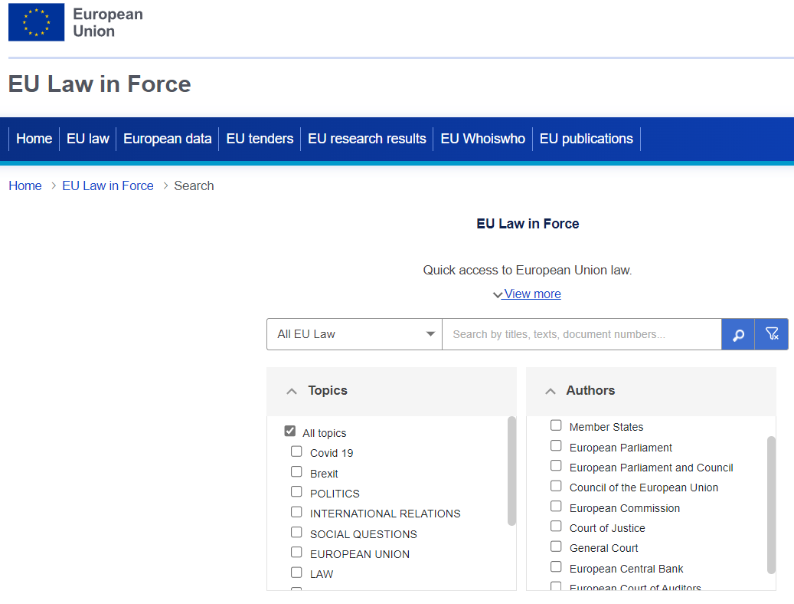
EU Law in Force
> https://op.europa.eu/en/web/eu-law-in-force
Focuses on core content and functionalities, compared to EUR-Lex
Provides quick and easy access to currently applicable EU legal rules
Aimed at non-experts

Slide 12
N-Lex
> https://n-lex.europa.eu/n-lex/
Central entry point to the law databases of EU Member States, where you can:
learn about the content of each country’s official database, including non-EU countries
search in your own language for legislation of one EU country or several EU countries at the same time
automatically translate the results (title and the document) of your search

Slide 13
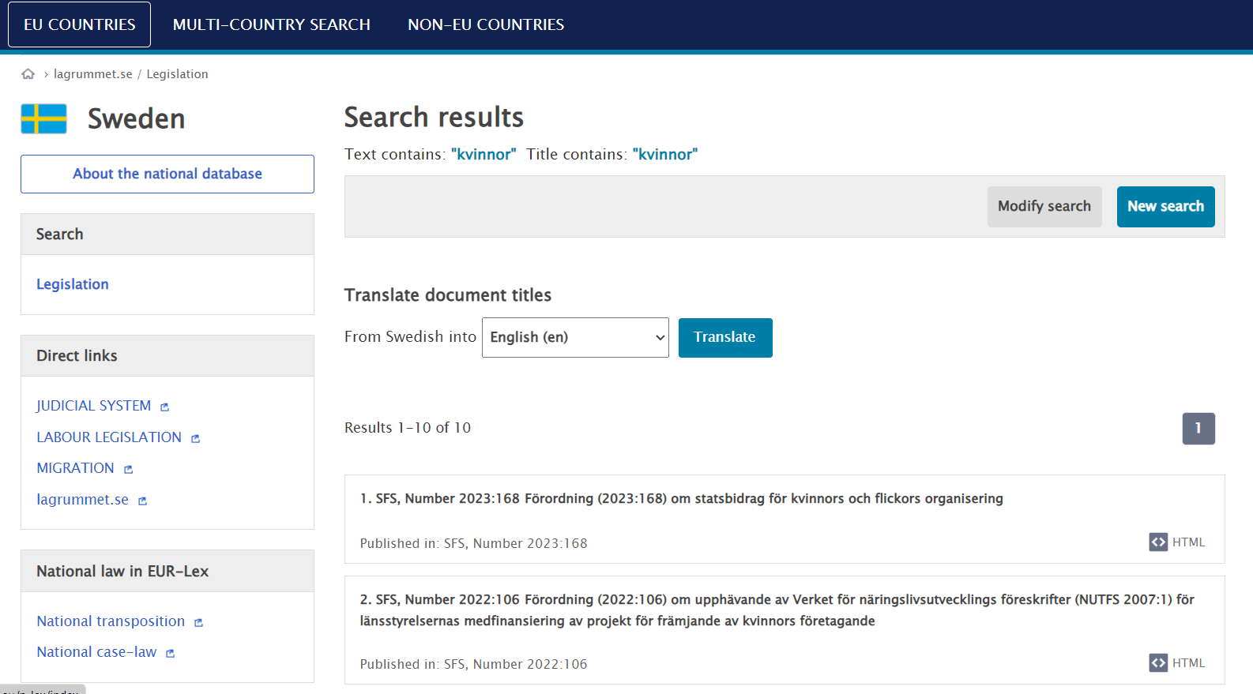
N-Lex

Slide 14
Thank you
Useful links
Helpdesk: EURLEX-HELPDESK@publications.europa.eu
Links : https://eur-lex.europa.eu/content/links/links.html
EUR-Lex on X : EUR-Lex (@EURLex) / X
Help pages:

Slide 15
Live demo
Directive 2010/31/EU of the European Parliament and of the Council of 19 May 2010 on the energy performance of buildings
Regulation (EU) 2020/852 of the European Parliament and of the Council of 18 June 2020 on the establishment of a framework to facilitate sustainable investment, and amending Regulation (EU) 2019/2088

