Slide 1
Notes:
Thank you, Manu – and welcome onboard, its already been a great pleasure. Dear hosts, directors, dear everyone -..My name is Tove Elise Ihler and I am the current chair of the EHLF, here to give you an update from the European Heritage Legal Forum. Its a pleasure to meet all of you again. I will talk about the legal forums work, the recent developments and the current challenging directives posing a negative impact to European cultural heritage.

Slide 2
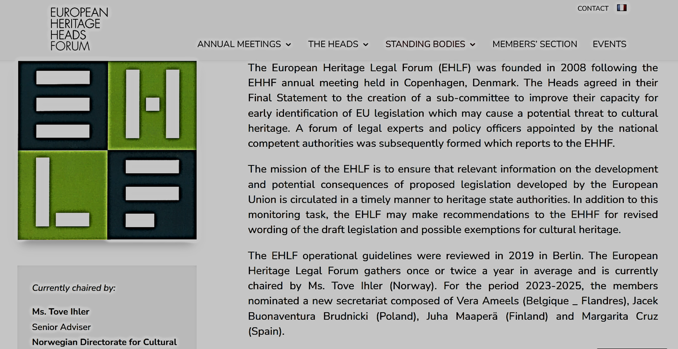
Notes:
I wanted to start with reminding everyone of the starting point of the European Heritage legal forum and the core activities in this sub comittee. If you look at the info at our webpage, it states that « The mission of the ……..» is to follow the new inititaives in EU – legislation, particularly the ones posing threats to the heritage in varoius forms - be it substances needed in heritage conservation beeing banned, energy regulations threatenig the historic buildings that need tailormade solutions to technically survive energy upgrade, in addition also to keep the heritage qualities intact. In other words: the observatory – function of the legal forum. Also, its says on the webpage that we shall communcate these findings to you, and your institutiins in a timely matter. That it what happens when we send you the alerts. And lastly, we may reccomend alternative wordning to the legal text from EU, that you can use – according to your countries mandate – towards the EU. This third step demands a collibaration in the legal forum, and in – depth work summing rethoric to convince EU to include exceptions for heritage in the regulation at hand. I want to highlight these three compents – the observatory function, the alerts, and the in depth legal work and collabiation and finding rhetoric - to make our work familiar to you.

Slide 3
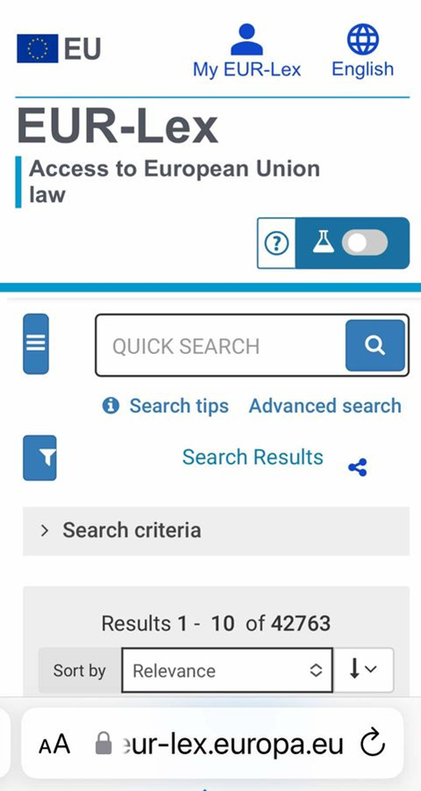
EHLF work – work and developments Improvements 2024
1. OBSERVATORYFUNCTION
CORE ACTIVITY IN EHLF.
NEWS FROM WHERE? EUR LEX / REPORTS FROM STAKEHOLDERS
BRUSSELS EUR LEX COURSE TO LIFT COMPETENCE AND ASSURE EACH MEMBERS BASIS FOR INDEPENDENT WORK
EMAIL EVERY MONDAY FROM CHAIR WITH REPORTS ON NEW FINDINGS – NEED MORE HANDS ON DECK
2. CIRCULATE INFO IN TIMELY MATTER TO YOUR INSTITUTIONS
ALERTS – A MEMO WITH SUGGESTED ACTION BY HEADS / MEMBERS
3. MAY MAKE RECOMANDATIONS FOR REVISED WORDING / EFFECT
IN ALLIANCE WITH OTHER DIRECTORATS, RESPONSIBLE FOR THE RELEVANT REGULATION
OPEN CALLS
GOLD STANDARD INSTEAD OF EXCEMPTIONS
EXPERT GROUPS
Notes:
So here it is.

Slide 4
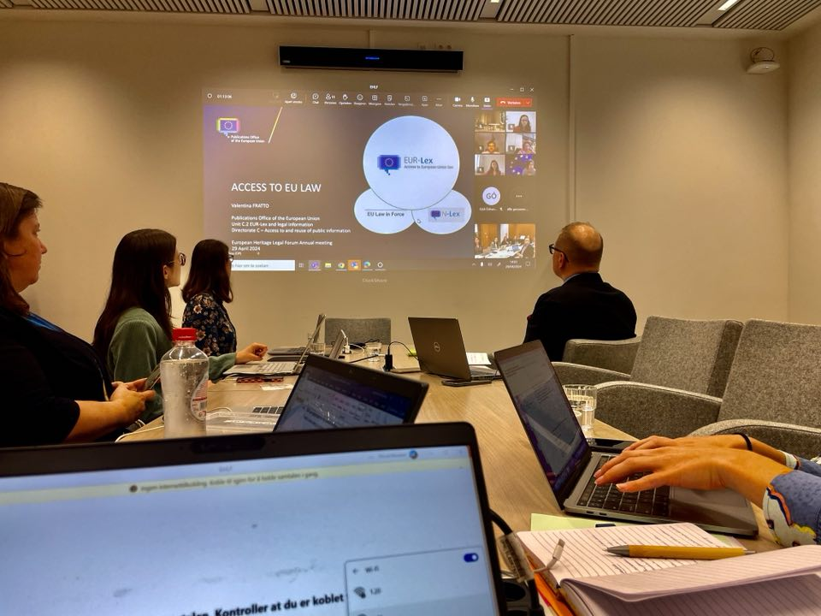
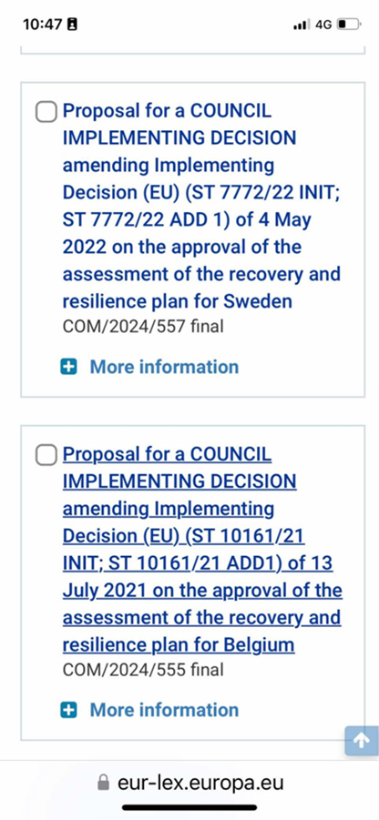
1. OBSERVATORY
WEEKLY REPORTS OF FINDINGS MIGHT BE OF INTEREST TO HEADS
- Let me/ Manu know if you want a copy. The findings are deciphered in the emails!

Slide 6
2. CIRCULATE IN TIMELY MATTER -Alerts
Sent by email from your secretary in Brussels ( Thank you Juliette - Welcome, Manu!)
Contains suggested actions performed according to Memberstates mandate.
Please read / react to ensure effect and impact on EU legislation

Slide 7
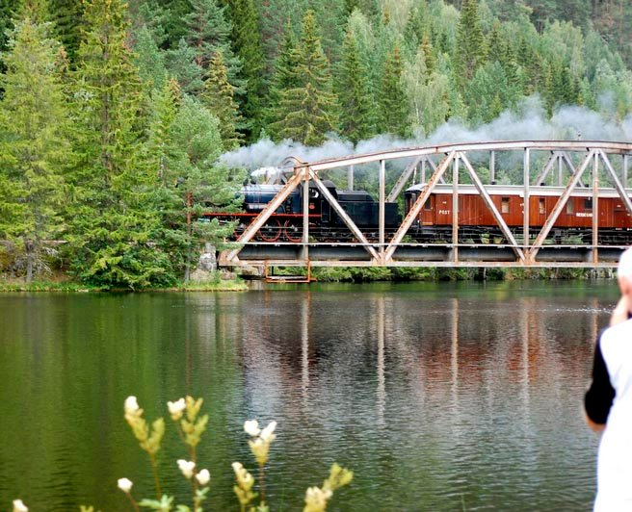
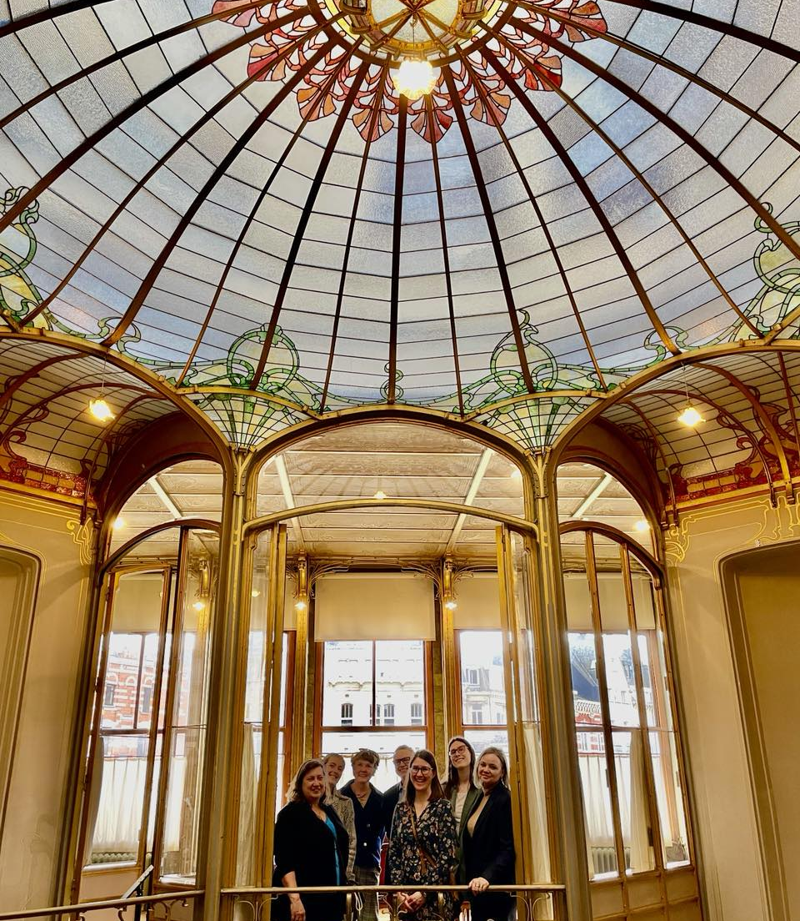
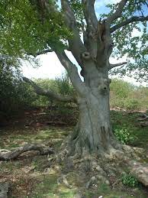
Alerts sent you in 2024
Creosote
Lead
Taxonomy
EPBD
Please inform/ include ongoing EU – work in EHLF to benefit all member states
Notes:
Legg inn bilde lead – kuppel, creosote -

Slide 8
To make that come into effect: WORK IN MEMBERSSTATE ACCORDING TO MANDATE FINDINGS, LAW & HERITAGE COMPETENCE – alternative wording – send back to EHLF Rhetoric to convince the commission - New developments, inspiration to change? Exemptions or gold standard for CH?
3. MAY MAKE RECOMANDATIONS FOR REVISED WORDING
Notes:
This is the stage where the work with the regulations goes deeper for EPBD, that EHLF followed since and at it first version in 2002, for the latest stages Germany, >Romania and Norway made and effort and we have a sucess story there. Now, there are new, dark skies on the horiizon and we need more heroes for our upcoming challenges. Please, if you want to get more involved, give room in the workday for your representative to work with eu – law. It is qiote satisfyuing and intersting if someone wants to work with international cultural heritage, and contrinute in a joint effort.

Slide 10
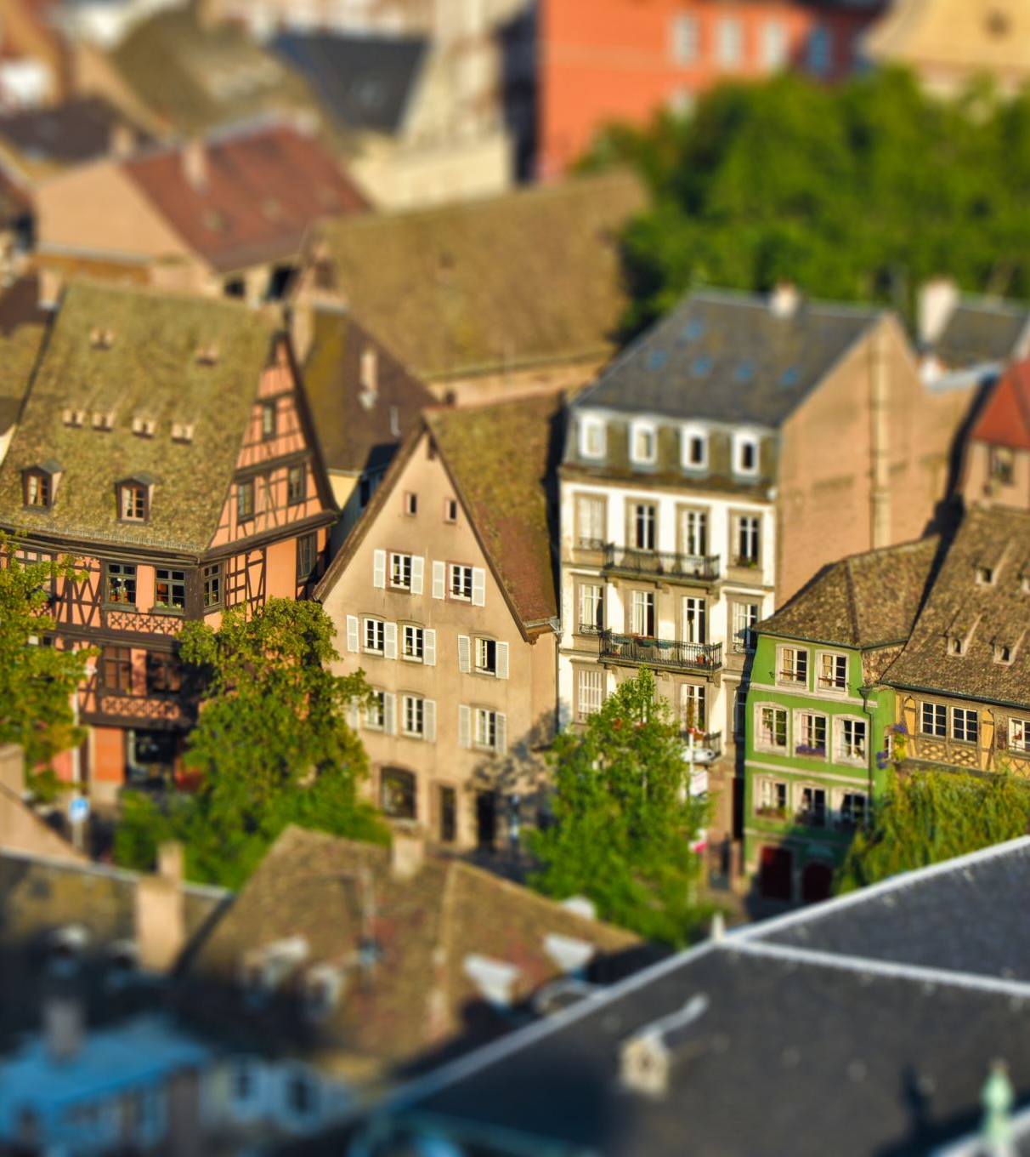
EU INITIATIVE TO WORRY ABOUT…
Taxonomy:
Historic buildings less attractive to upgrade and invest in
Criteria for purchase: A or amongst the 15%
Please see details in the alert sent you through secretariat – we need to act together
Notes:
Our big dark sky is now taxonomy. The intentions is good, but we need tailormade solution for our heritage to reach both our goal - to preserve heritage, and the goal of the taxonomy: to ensure a suistanable economy in the EU.
By passing the Green Deal in 2019, the European Union set the course for more sustainable investments in areas like renewable energy, biodiversity, or circular economy. The ultimate goal is to reach a climate-neutral economy in the EU by 2050. By 2030, there shall already be a 55% reduction in greenhouse gas emissions. To achieve these climate targets, the Green Deal includes an investment plan of 1 trillion euros over the next 10 years. However, despite this huge investment, the EU depends also on the support of the private sector to achieve the Paris climate agreement. That’s where the EU Taxonomy Regulation comes in.
As part of the European Green Deal, the EU Taxonomy Regulation (2020/852/EU) sets a framework for the concept of sustainability, defining exactly when a company or enterprise is operating sustainably. It defines activities. The EU Taxonomy Regulation sets criteria to determine if an economic activity can be considered environmentally sustainable. Therefore, an economic activity has to be assigned to a defined taxonomy activity by the EU, contribute substantially to one of six defined environmental objectives, does not significantly harm any of the remaining environmental objectives, and complies with a series of minimum social safeguards.
EPBD
What is your experience?
Baltic region heritage comitee, thoughts on impleneting article 5 and 9 nationally.
Question from masterstudent: Seperate funding for energyupgrade in historic buildings?
Also linked to the standardization work.
Kategorien Kjøp og eierskap til bygninger stiller krav om energimerke A for å bli klassifisert som bærekraftig. Veldig få kulturminner vil være i stand til å nå opp til dette. Det finnes imidlertid et alternativt kriterie i taksonomien som sier at bygningen også kan ha et operasjonelt energibehov som ligger blant de 15% beste. Dette kriteriet har vi ikke forsøkt oss på å fortolke da vi mangler data om «tilsvarende bygningsmasse nasjonalt eller regionalt» for alle de bygningskategorier vi eier, inkludert kulturminner.
Kommunaldepartementet har tidligere kommet med en fortolkning om hva som er definisjonen på en nær-null energi bygg – som også var et punkt som vær uklart i den norske tilpasningen til taksonomien. Vi ser det som naturlig at norske myndigheter bidrar til å avklare hva som menes med 15% beste. Jeg hadde sett det som naturlig at man på en eller annen måte klarte å fange opp kulturminner i denne tilpasningene.
Hvilke erfaringer har andre land gjort seg?

Slide 11
To which companies does the EU Taxonomy apply?
The EU Taxonomy is linked to the obligation for non-financial reporting under the CSR Directive Implementation Act (CSR-RUG) or the Corporate Sustainability Reporting Directive (CSRD), which will replace the Non-Financial Reporting Directive (NFRD) in the future. Both regulations follow the objective of the Green Deal and have the following key goals:
1. Reorient capital flows to sustainable investments 2. Establish sustainability as a component of risk management 3. Encourage long-term investment and economic activity
Is the EU Taxonomy mandatory for my company? And if so, from when does the EU Taxonomy apply? This is what many companies ask themselves. The EU Taxonomy considers different circumstances and obligations for different economic actors. These are divided into the following groups:
Large public-interest companies already subject to the NFRD
All large companies that are not presently subject to the NFRD, meeting two out of three CSRD criteria: a) on average 250+ employees, b) balance sheet of EUR 25,000,000+, c) net turnover of EUR 50,000,000+ Note: Since December 2023, new thresholds for balance sheet and net turnover have applied for all company sizes; see updated list above.
Listed SMEs and other undertakings
Financial market participants, including occupational pension providers, that offer and distribute financial products in the EU (including those from outside the EU)
Draft: Non-EU companies with a net turnover over EUR 150,000,000 in the EU, if they have at least one subsidiary or branch in the EU and exceed certain thresholds
However, companies of any size can use the EU Taxonomy on a voluntary basis to show investors and stakeholders in general whether they are carrying out or planning sustainable activities. Disclosure on the EU Taxonomy is only mandatory for companies that fall within the scope of the NFRD/CSRD.

Slide 12
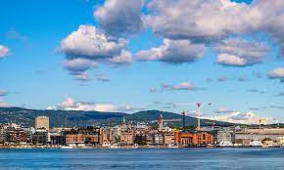
We need more active members
Board welcome to Oslo 2025
Full meeting in 2025

Slide 13
Is your country represented? Is your EU –regulation work included in the forum?
Look at our sucessstory EPBD – still needs follow - up
New dark skies - taxonomy
Need new and old heroes! Solidary work
Notes:
My next and last point, is to encourage you to contribute and collect the already excisiting work towatds EU in EHLF. IN sevilla, I mentioned our sucessstry in the EÅBD. That sucess was secured by at the time actibe members from Germany, Romania and Norway. As you see, we have new thres om the horoson, and for this we need new heroes to make active contributions. I hope you take time to read the alerts, find people to - in some cases it is heads – level, and spread the infp to the countries in our group. Thank you so much for you r kind attention, please do not hesitate to get back to me if you have any questions.

